Slide 1
Special Education Leaders' Meeting
March 11, 2022

Slide 2
CONTENTS
01
DESE/DDS Residential Prevention Program
02
MassHire Recruitment Supports
03
State and Federal Updates
04
Q&A
Notes:
Lauren

Slide 3
Shayne McClendon
I will breathe. I will think of solutions. I will not let my worry control me. I will not let my stress level break me. I will simply breathe. And it will be okay. Because I don’t quit.
Shayne McClendon

Slide 4
DESE/DDS Residential Prevention Program
01

Slide 5
DESE/DDS Residential Prevention Program
March 11, 2022
Beth Doyle, M.ed, cags
Education Program Manager, dese/dds program

Slide 6
What it is and who we support
https://www.mass.gov/dese-dds-program
Wrap Around Program
  In home and community supports
Our Participants
  6-21 years old
  DDS Child Eligible
  Served by an IEP
  Living in a family or caregiver’s home
    No group homes
OPEN INTEREST
MAR 1 to Mar 31

Slide 7
Cornerstone of the program
3 hours of skills training weekly
Skill Building
Independence
Community Integration
Chores
Self-Regulation
Individually determined therapies
Travel experience
Safety in the community
Routine interactions with community members
Self-determination model
ADL and IADL practice
Family confidence and capacity in supporting their child
Notes:
Self-direction
Individualization
Family driven goals
In-home supports and therapies are crucial
Community integration and involvement

Slide 8
Benefits for participants
Dedicated Family Navigator
Comprehensive plan developed in collaboration with families
Schedule works around family
The 55/45 Rule
Notes:
43 Qualified family navigators
37 Active agencies
Families can choose any navigator that works within their region
links all components of the program (your own personal program concierge)
Participants work on 2-5 goals, on average
Evenings and weekends
Services and Supports: skills training, senior level therapists (BCBA, PsyD), therapies (music, aroma, arts, biofeedback), peer mentors, respite
Goods/Reimbursements: Community Activities, outing costs, family training, specialized nutrition, safety equipment, uncovered medical

Slide 9
MassHire Recruitment Supports
Sacha Stadhard, Manager of Policy and Program Administration
02

Slide 10

Welcome to MASSHIRE

Slide 11
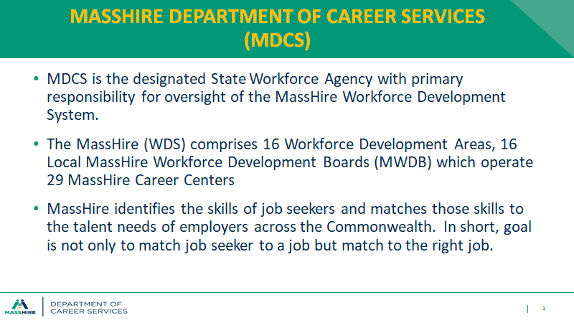
MASSHIRE Department of Career Services (MDCS)

Slide 12
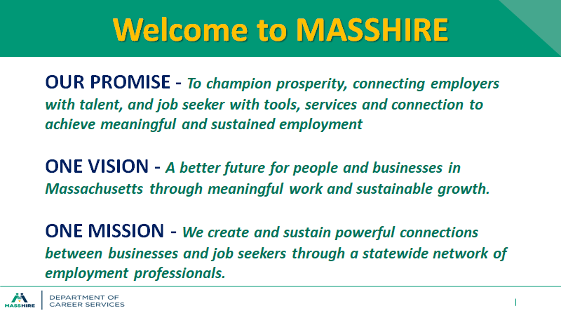
Welcome to MASSHIRE

Slide 13
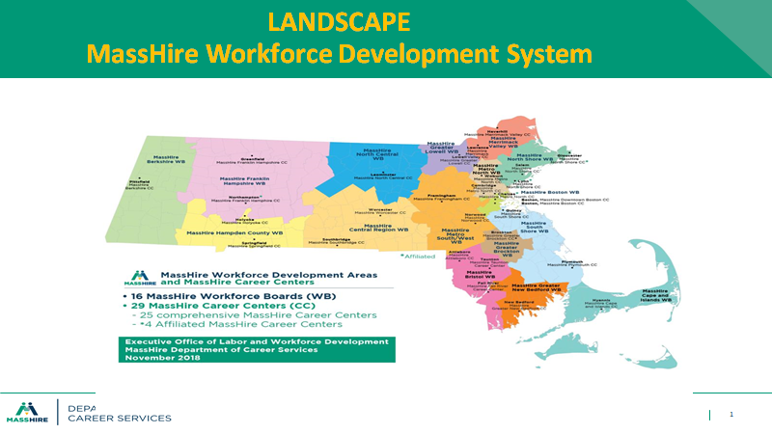
LANDSCAPE MassHire Workforce Development System

Slide 14
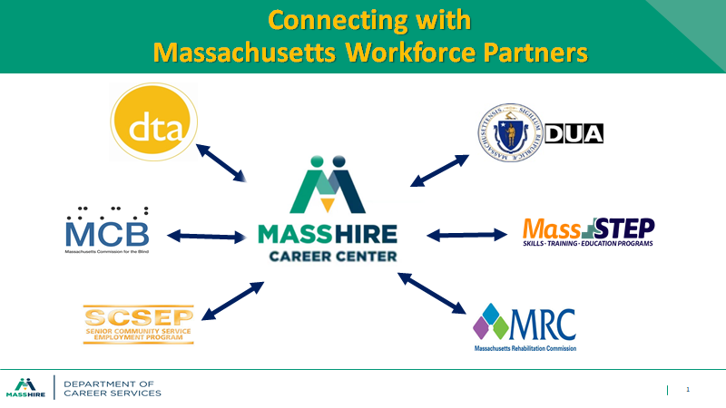
Connecting with Massachusetts Workforce Partners

Slide 15

MassHire Creer Center Services: Job Seeker Services

Slide 16
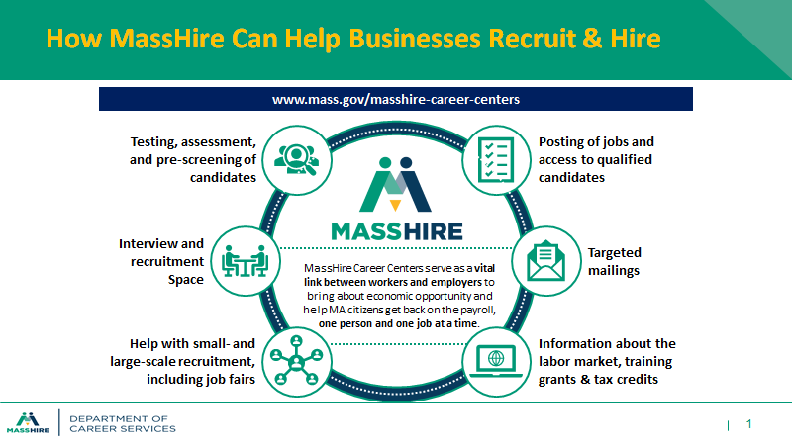
How MassHire Can Help Bussinesses Recruit & Hire

Slide 17

Let’s Get to Work

Slide 18


MASSHIRE Job Fair with Metro North Career Center
April 6, 2022 10:00 – 12:00pm
For Link to Website & Flyer – Click Here

Slide 19
State and Federal Updates
03

Slide 20
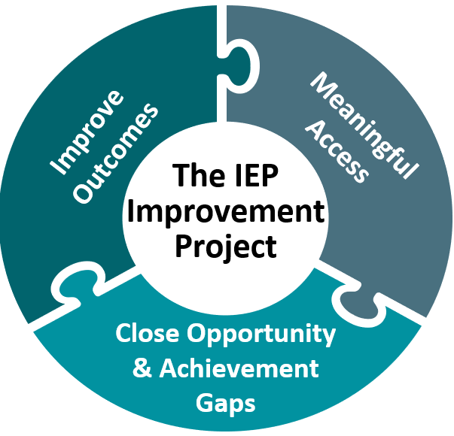
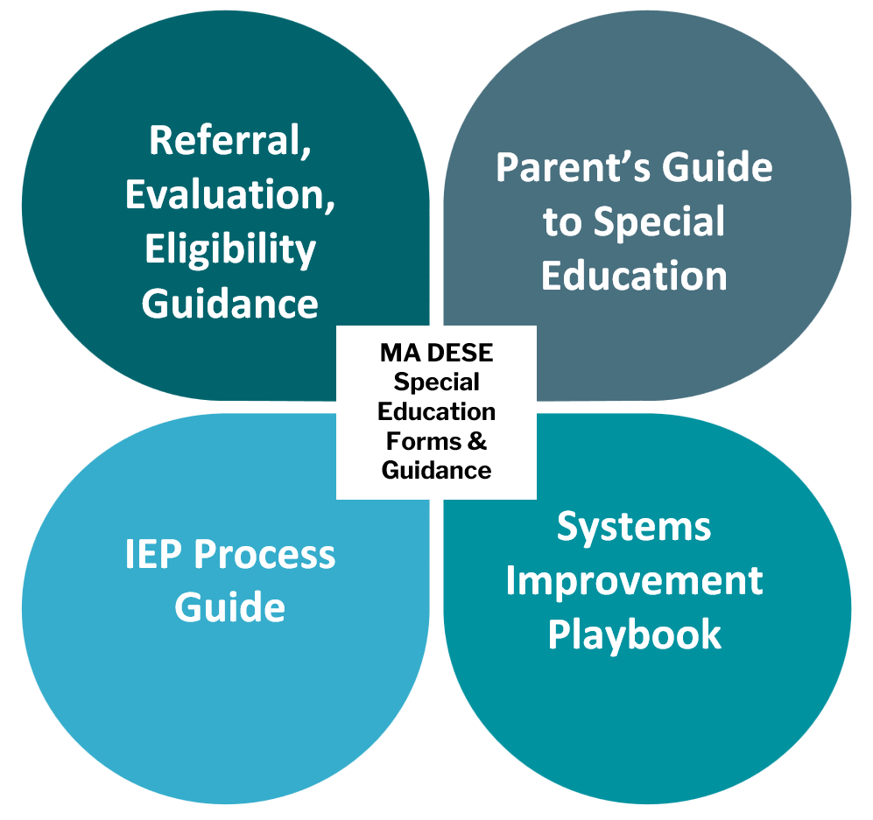
The IEP Improvement Project
MA DESE Special Education Forms & Guidance

Slide 21
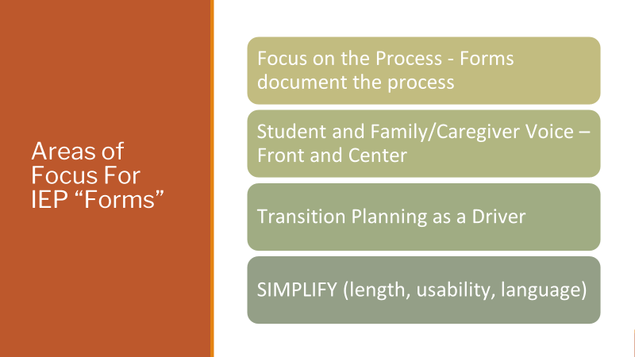
Areas of Focus For IEP “Forms”

Slide 22
IEP Improvement Project Update
Referral, Evaluation, and Eligibility
  RLO Posted
  Supplementary Documents - 2023
IEP Forms
  SEPP State Scan of IEP Forms and Processes – Completed Summer 2021
  Draft Forms – Spring
  Stakeholder Feedback – Late Spring
Process Guide – Late Spring
Parent's Guide – Summer
Systems Improvement Playbook – 2023

Slide 23
Welcoming Newcomer and Refugee Students
Notes:
Link to memo: https://www.doe.mass.edu/news/news.aspx?id=26713

Slide 24
Background: Increasing refugee & newcomer populations across MA
2.4.22 Report on Afghan Refugees from US bases | 2.4.22 Report on Afghan Refugees from US bases to ORI
 | Arrived in MA | Expected by 2/15
Massachusetts | 1,725 | 1,914
Boston | 166 | 187
Florence | 82 | 83
Lowell | 207 | 233
Roxbury | 174 | 214
South Boston | 147 | 149
Springfield | 141 | 148
West Springfield | 223 | 254
Worcester | 585 | 646
Many refugees and newcomers from Haiti, Guatemala, Brazil, and other parts of Central America are relocating in:
Amherst
Boston
Framingham
Lowell
Ludlow
Medway
Newburyport
Saugus
Springfield
West Springfield
And so many more…
Beginning to enroll Ukranian refugee students.
Notes:
As a result of various global circumstances, districts across Massachusetts have seen an increase in recent months of newly arrived students, many of whom are refugees resettling in communities throughout the state.
Some communities, for example, are welcoming Afghan families as part of Operation Allies Welcome, while others are seeing an increasing number of new arrivals from Brazil and Central America.
Many of these newcomers are school-aged children who require enrollment in school as soon as possible.
They may be residing with friends or relatives and may have needs that require various support services, and some may be students with limited or interrupted education (SLIFE), exacerbated by the ongoing pandemic

Slide 25
Enrollment
Newcomer & refugee students are legally entitled to a free public education without regard to their or their parents' or guardians' national origin or immigration status.
Districts should enroll students as soon as possible.
If typical enrollment documents are not available, work with families to identify alternative means (e.g., to establish residency or age) to facilitate prompt enrollment.
Arrange for translation and/or interpretation during and after enrollment.
In some instances, students may qualify as homeless (e.g., living in hotels, shared housing, transitional shelters, etc.) and therefore entitled to immediate enrollment under federal law (McKinney-Vento) even if they lack typical enrollment paperwork. See McKinney-Vento Homeless Education Assistance Advisories.

Slide 26
English Learner Services
School districts must:
Identify in a timely manner English learners in need of English language services, and provide such services in accordance with applicable laws, regulations, and guidance.
Identify whether students are SLIFE (students with limited or interrupted formal education) and need additional supports.
Provide essential information to families in a language they understand.
See:
Guidance on Identification, Assessment, Placement, and Reclassification of English Learners and
Massachusetts Students with Limited or Interrupted Formal Education (SLIFE) Definition and Guidance.
Additional resources for engaging with families using culturally and linguistically sustaining practices.

Slide 27
Special Education Services
School districts must:
Ensure that all children ages 3 through 21 who have a disability are identified, located, and evaluated to determine eligibility for special education services in a timely manner.
Ensure ELs with disabilities receive both the language supports and disability-related services to which they are entitled by law.
Ensure that assessments used to evaluate a student's eligibility for special education services are not discriminatory on a racial or cultural basis and are "provided and administered in the child's native language or other mode of communication and in the form most likely to yield accurate information on what the child can do academically, developmentally, and functionally, unless it is clearly not feasible to so provide or administer." 34 C.F.R. 300.304(c)(1).
Ensure the IEP Team includes participants who are knowledgeable of the child’s language needs and who have training in second language acquisition.
See:
Guidance for Supporting English Learners with Disabilities
U.S. Department of Education's English Learner Toolkit (Chapter 6)

Slide 28
Resources
Memo includes a variety of resources for schools & districts about:
Supporting students & families who have experienced trauma
Supporting newcomer & refugee students in general
Welcoming and supporting Afghan refugees
These resources can be found on the Office of Language Acquisition's page Resources for Supporting Immigrant & Refugee Students (this page will be updated on ongoing basis).

Slide 29

Guidance on Attendance Policies
February 2022

Slide 30
Guidance on Attendance Policies
February 2022 guidance document
Supports the development of or updates to each school district's attendance policies and practices.
Key terms and definitions, brief overview of laws on compulsory school attendance, responsibilities of parents/guardians, school committees and schools, recommendations for written policies, and sample best practices.
Information about chronic absences, truancy, and dropping out.

Slide 31

New OCR Fact Sheet: Compensatory Services Under Section 504

Slide 32
New Federal 504 Compensatory Services Fact Sheet
U.S. Department of Education’s Office for Civil Rights (OCR)’s new fact sheet: https://www2.ed.gov/about/offices/list/ocr/docs/factsheet-504.html
Regardless of the challenges schools face during the pandemic, students with disabilities retain their right to FAPE under Section 504 of the Rehabilitation Act of 1973.
  Guidance on FAPE under Section 504: https://www2.ed.gov/about/offices/list/ocr/docs/edlite-FAPE504.html
Under Section 504, students with disabilities may be entitled to compensatory services if they did not receive appropriate evaluations or services during the pandemic.

Slide 33
Federal 504 Compensatory Services Fact Sheet: Required Process
If a student with a disability did not receive appropriate evaluations or services, including the services that the school had previously determined they were entitled to, then the school must convene a group of persons knowledgeable about the student to make an individualized determination whether, and to what extent, compensatory services are required.
Knowledgeable persons may be, for example, school nurses, teachers, counselors, psychologists, school administrators, social workers, doctors, and/or family members.
Ideally, the team of knowledgeable persons will come to a mutually acceptable decision regarding compensatory services to mitigate the impact of the COVID‑19 pandemic on the child’s receipt of services.

Slide 34
Questions and Answers on Serving Children with Disabilities Placed by Their Parents in Private Schools (rev. Feb 2022)

Slide 35
Q&A on Serving Children with Disabilities Placed by Their Parents in Private Schools
New guidance from the Office of Non-Public Schools, Feb. 2022
Topics include various topics, including:
Child Find and Evaluations
Consultation
Equitable services, including services plans
Location of services
Allowable expenses

Slide 36
IDEA Equitable Services
Resolution Funds
Reminder: Must Submit Mid-Year Self-Assessments for Resolution Funds (Expenditures)

Slide 37
Special Education Determinations – Accountability & Assistance

Slide 38

Support for LEAs in
Needs Assistance (NA) or Needs Intervention (NI) categories
Webinar: April 28th, 11:00 – 1:00 PM
  LEAs with a:
    NA determination – attendance required
    NI determination – attendance recommended
    Meets determination- attendance is not required
  Webinar will include:
    More information about how determinations were made
    Initial support
    Targeted resources
    Information regarding fiscal implications
  Please contact specialeducation@doe.mass.edu with any questions.
Notes:
All LEAs are welcome to attend – however, NA district must attend, and we recommend NI district attend
A member of the Department's special education team will contact you with details soon - via email
More detailed information regarding the rubric calculations will be provided
Targeted resources will include:
Caitlin - MOE
Lisa Harney – grad & drop out resources/strategies
Holly & Juin – LRE resources/strategies
PSM – tiered monitoring & findings
PRS – complaints & findings
Brian – Ind 4, 9, 10, Sig Dispro resources/strategies
Ellie - grants
Almost all questions SEPP has received so far are about 1-3.
As part of our coordination and aligned assistance, also in attendance:
SEPP staff
PSM staff
SSOS staff
OST staff
CSSRD staff

Slide 39
Special Education Updates
Use this link to subscribe and see past issues:
https://us14.campaign-archive.com/home/?u=d8f37d1a90dacd97f207f0b4a&id=41b37f7347

Slide 40
Upcoming Special Education Leaders’ Only Zoom Meetings
Thursday, April 14 at 11 a.m. Friday, May 13 at 11 a.m. Friday, June 10 at 11 a.m.

Slide 41
Q&A
04

Slide 42
THANK YOU

