Slide 1
Special Education Leaders Meeting
Friday, April 28, 2023

Slide 2
Agenda
Special Education Updates
New IEP Update
Proposed New Options for Special Education Licensure

Slide 3
Special Education Updates

Slide 4
Restraint/Seclusion* Reduction Initiative Opportunities
Join the Interagency Advisory Committee
This prevention initiative brings together leaders of various state agencies and partner organizations.
Together, the committee focuses on efforts to prevent and reduce the use of restraint and seclusion across human service organizations.
The Committee is currently looking for school and district leaders interested in joining the Committee, which meets quarterly.
If you are interested please contact Natalee Salmon at natalee.salmon@mass.gov.
* Seclusion is prohibited in publicly funded elementary and secondary education programs in MA.

Slide 5
Restraint/Seclusion Reduction Initiative Opportunities
Upcoming Training
DMH’s 23rd Annual Provider Forum on Restraint and Seclusion Prevention
Thursday, May 11th, 2023
9:00 AM – 12:00 PM EST Via Zoom
Link for Training Registration
More Information about the Restraint/Seclusion Reduction Initiative

Slide 6
March 24, 2023 Letter from Secretary Cardona
Letter calls for an end to corporal punishment in schools.
Already prohibited in MA. G.L. c. 71, sec. 37G.
Make every effort to provide children with safe and supportive environments that protect and enhance their physical, emotional, and mental well-being.
Evidence-based strategies, such as multi-tiered systems of supports and positive behavioral interventions and supports, and other research-backed educational practices are designed to meet students' social, emotional, and mental health needs and improve school climate and safety.
Review footnote 1: discussion of restraint and seclusion, as well as resources issued by U.S. Department of Education

Slide 7
Massachusetts Inclusive Concurrent Enrollment Initiative (MAICEI)
Now codified in Mass. General Laws c. 15A, §30A; c. 71B, § 17
Promotes higher education opportunities for students with intellectual disabilities, autism, and other developmental disabilities
Expands funding sources
Requires all state colleges and universities to establish guidelines for student selection​
Includes state disability agencies in the Partnership Leadership Team

Slide 8
IDEA Grants (Fund Code 240 and 262)
Grants for Education Management System (GEMS)
Grants will be in GEMS on July 1, 2023
Requirements:
FY2024 Conditions for Assistance must be uploaded
Written Affirmation for Resolution Funds must be uploaded
Updated General Education Provisions Act (GEPA) Statement will be part of the grant application
Training for LEA representatives in June
IDEA grant application training

Slide 9
Reminder from OSEP: Tiered Systems of Support
Multi-Tiered System of Supports (MTSS)/Response to Intervention (RTI) Process Cannot Be Used to Delay/Deny an Initial Evaluation (April 10, 2023)
OSEP Memorandum 11-07- RTI Process Cannot Be Used to Delay-Deny an Evaluation for Eligibility under the Individuals with Disabilities Education Act (IDEA) (January 21, 2011)
OSEP Memorandum 16-07- A Response to Intervention Process Cannot be Used to Delay-Deny an Evaluation for Preschool Education Services under IDEA (April 29, 2016)
* The memos apply to tiered systems of support including MTSS.

Slide 10
Key Takeaways from the OSEP Memos
LEAs must ensure there are systems in place for meeting the child find requirements as a condition for funding.
IDEA Part B regulations at 34 C.F.R. §300.301(b) allow a parent to request an initial evaluation at any time to determine if a child is a child with a disability under IDEA.
MTSS may not be used to delay or deny a full and individual evaluation under 34 C.F.R. §§300.304-300.311 for a child suspected of having a disability.
IDEA does not require or encourage a local or preschool program to use an MTSS approach prior to referral for evaluation or as part of determining whether a 3-, 4-, or 5-year-old is eligible for special education and related services.
Once an LEA receives a referral from a preschool program, the LEA must initiate an evaluation process to determine if the child is a child with a disability.

Slide 11
New IEP Update

Slide 12
Final IEP Form
Style and formatting updates
Technical changes
Added “systems” to AAC considerations
Eliminated references to recommended sections
Inserted dotted-line box around transition section
Changed “adult living” to “independent living”
Updated transfer of rights and decision making sections
Restored A, B and C services on the grid
Condensed partial rejection response

Slide 13
Training and Professional Development
IEP Improvement Project

Slide 14
Office Hours
Wednesday, April 26, 2-3 pm
Wednesday, May 24, 2-3 pm
Thursday, June 15, 2-3 pm

Slide 15
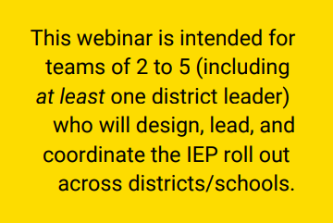
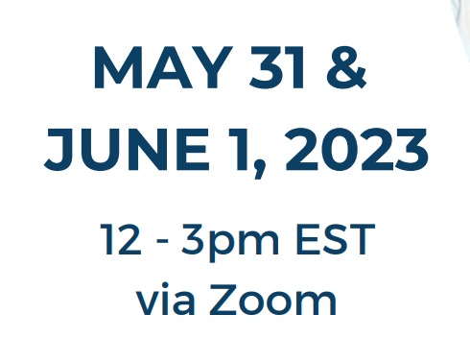
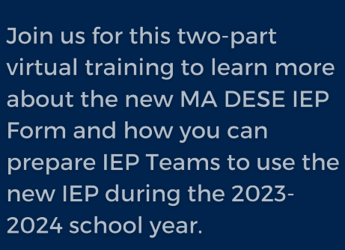
MA Training of Trainers Upcoming Professional Development

Slide 16
What’s Coming?
Translated IEP Form (16 Languages)
Fillable PDF
Process Guide
Sample IEPs
Crosswalk (Current and New IEP)

Slide 17
Implementation of Funding Support
What: Grant funds to support implementation and software adaptation
When: Available FY2024; More information in early summer
Who: Available to LEAs, Approved Special Ed. Schools, and Collaboratives

Slide 18
Summary of Survey Responses
https://survey.alchemer.com/s3/7277239/Special-Ed-Leaders-IEP-and-PD-Survey

Slide 19
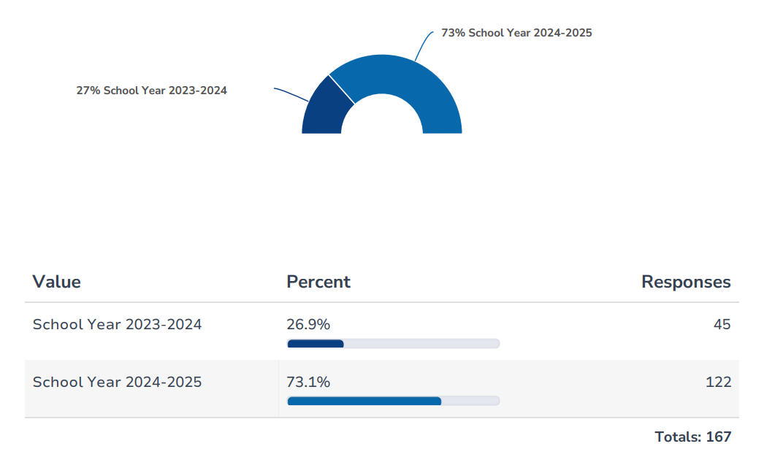
Survey Results: # of Responses

Slide 20
Top Ten Topics for Professional Development
Updated IEP Form and Process – 87.5% (147)
Addressing mental health, social, emotional, and behavioral needs of students with disabilities - 60% (101)
Personnel – Recruitment, Preparation, PD, Training – 43.5% (73)
Fiscal Matters Related to Special Education – 32.1% (54)
Special Education Determinations – 31.5% (53)

Slide 21
Top Ten Topics for Professional Development
Complaints and Dispute Resolution (Indicators 15 & 16) – 26.8% (45)
Inclusion/LRE (Indicators 5 & 6) – 25.6% (43)
Secondary Transition & Post-School Outcomes (Indicators 13 & 14) – 23.8% (40)
Discipline (Indicator 4) – 20.2% (34)
Equitable Services – 16.1% (27)

Slide 22
Proposed New Special Education License Options

Slide 23
Proposed Amendments to 603 CMR 7.00
Allow educators with Initial and Professional licenses to obtain Provisional licenses in special education areas and in English as a Second Language;
Create a new grade span, PreK-2, for two licenses:
teacher of students with moderate disabilities and
teacher of students with severe disabilities
Permit applicants for Provisional licenses to meet a requirement through demonstrating knowledge, as an alternative to meeting the requirement by taking a course or seminar; and
Create a new Provisional license for school nurses.
Read full memo to Board of Elementary and Secondary Education here.

Slide 24
Q&A

