Slide 1
COVID-19 Testing Update: Spring, Summer, Fall 2022 Updates and Guidance for Schools, Childcare and Children’s Recreational Camps/Programs
May 25, 2022

Slide 2
Resources for Responding to National Tragedies
Talking to Children about Violence: Tips for Parents and Teachers (NASP)
Managing Your Stress in the Aftermath of a Shooting (APA)
National Parent Helpline
How to Talk to Kids About School Shootings (Common Sense Media)

Slide 3
Today’s Presentation
Department of Elementary and Secondary Education
Executive Office of Health and Human Services
Department of Public Health
Jeffrey Riley, Commissioner of Education
Russell Johnston, Deputy Commissioner
Lauren Woo, Strategic Transformation Director
Jeremiah Hay, Deputy Chief of Staff
Meg McEvoy, Strategy Manager
Catherine West, Senior Director
Samantha Joseph, Outreach and Engagement Team Lead
Notes:
Russell

Slide 4
CONTENTS
01
COVID Testing Data
02
Changes to K-12 COVID-19 Testing Program
03
Q&I Guidance for Schools, Childcare and Children’s Recreational Camps/Programs
04
School-based Vaccine Clinics
Notes:
Lauren

Slide 5
COVID Testing Data
01

Slide 6
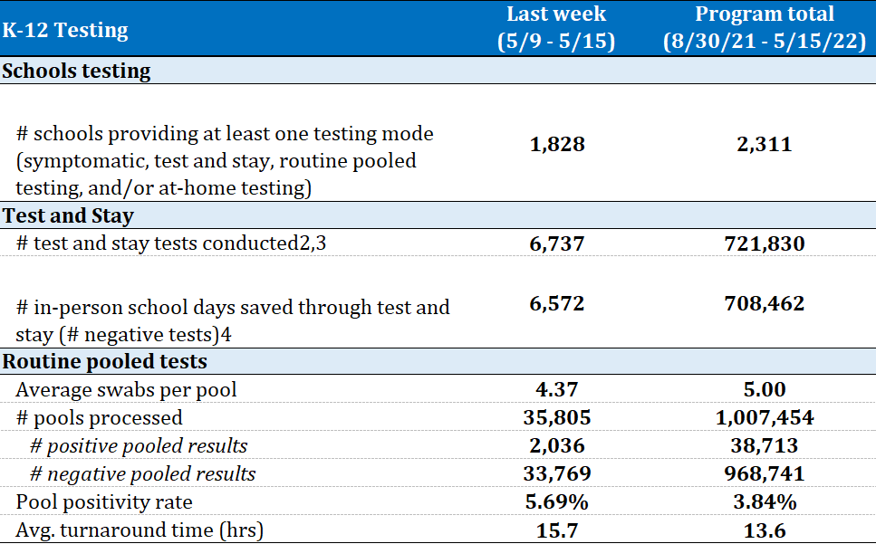
COVID-19 Testing data

Slide 7
Changes to K-12 COVID-19 Testing Program
02

Slide 8
Remainder of SY2021-2022
For the remainder of the 2021-2022 school year, the statewide K-12 COVID testing program will remain in place as it currently exists.

Slide 9
Remainder of SY2021-2022 continued
Self-tests may be made available for the school community more widely, in accordance with the state’s general self-test guidance.
Districts and schools can choose to make self-tests available prior to in-person, school-sponsored events, but students and school community members cannot be required to test as a condition of attendance.
Districts and schools should continue to request that participants opt-in to self-tests in order to receive them.

Slide 10
Summer/Fall 2022
The end of the current school year (SY2021-2022) will mark the end of the state-run, state-coordinated K-12 testing program.

Slide 11
Summer 2022
We will continue to provide self-tests for symptomatic testing for school-based summer programs (e.g., summer school, acceleration academies, ESY)
Please note, these tests are not for summer camp use. Summer camps should be directed to DPH.
Staffing, software and other services provided through CIC Health will no longer be available.
Districts and schools will need to provide staffing for in-school symptomatic testing for school-based summer programs.

Slide 12
Summer 2022
Districts and schools will have access to view past consents and results in their testing portal.
Districts and schools should obtain a new consent for summer and fall 2022 symptomatic testing.

Slide 13
Ordering self-tests for summer 2022—Schools and districts already participating in self-test option
Districts and schools operating school-based summer programs (e.g., summer school, acceleration academies, ESY), should place an order for self-tests via the CIC supply hub.
To order self-tests for school-based summer programs, districts and schools must update the total number of required summer tests in the CIC supply hub by Wednesday, June 1, 2022.
CIC will distribute a one-time allocation for summer use, alongside the normal at-home opt-ins, during the week of June 6.

Slide 14
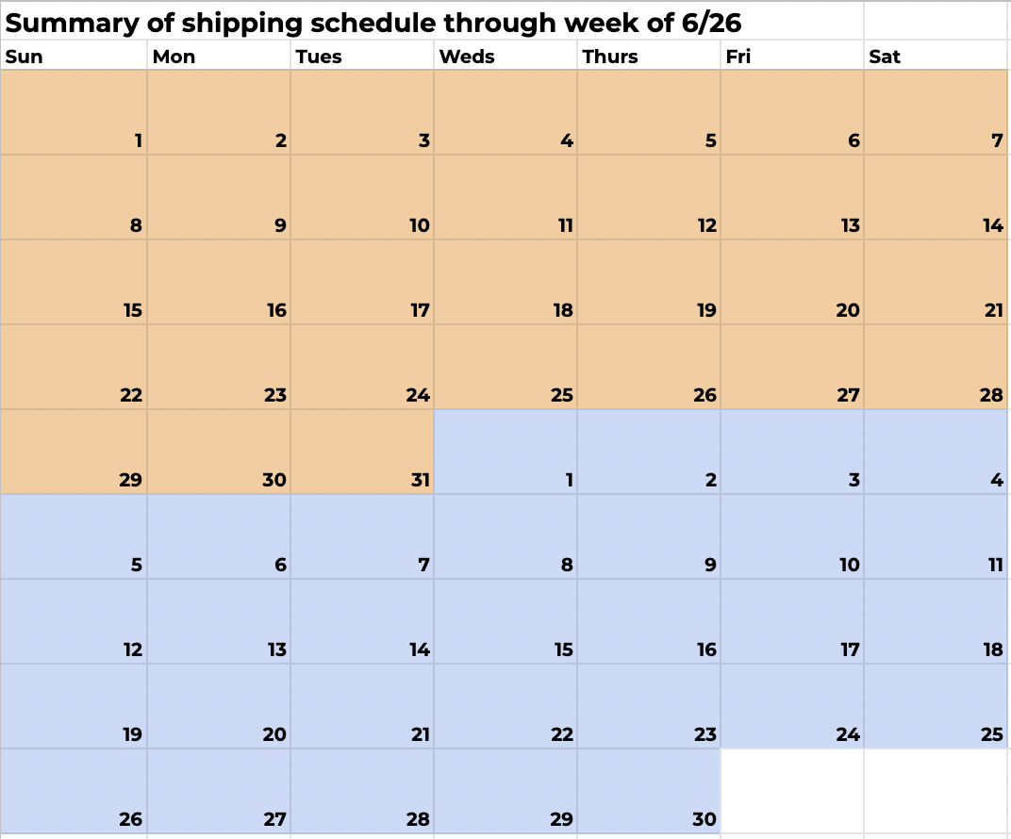
Self-test ordering and distribution calendar – June 2022
No Deliveries
All received previous week
Deadline for student & staff qty. changes
Student & Staff Deliveries
No Deliveries
All received previous week
Deadline for student & staff qty. changes
Student & Staff Deliveries
No Deliveries
All received previous week
Deadline to order for school-based summer programs
Student & Staff Deliveries
No Deliveries
All received previous week
Deadline for student & staff qty. changes
Student & Staff Deliveries
No Deliveries
All received previous week

Slide 15
Important Points
Please include the total number of self-tests you expect to use during your summer program (if applicable) in your order on June 1.
Please add this number to your regular order for that two-week period (summer order + regular order)
If you are ordering self-tests on June 15, you will need to manually enter the number of tests you are ordering.
We will not carry over your order number from June 1.

Slide 16
Ordering self-tests for summer 2022—Schools and districts NOT participating in self-test option
The limited number of schools and districts not participating in the statewide self-test option should email k12covid19testing@mass.gov to request self-tests for school-based summer programs.

Slide 17
Fall 2022
The state will no longer supply self-tests to schools beginning in Fall 2022.
For SY2022-2023, schools and districts interested in implementing their own testing program are encouraged to limit that program to symptomatic rapid testing only.
Schools and districts may purchase self-tests through the statewide contract for self-tests.

Slide 18
To Review
 | Spring 2022 | Summer 2022 | Fall 2022
Surveillance (both pooled and self-tests) & Test and Stay testing | Current program continues | No state program support | No state program support
Symptomatic testing | Current program continues | Schools will have access to state-provided self-tests for school-based summer programs | Schools can purchase self-tests through statewide contact
CIC Health Support (including managing consent forms) | Current program continues | CIC Health services no longer available through the state | CIC Health services no longer available through the state

Slide 19
REMINDER: Updating Participating Student and Staff Numbers
Navigate to the CIC Health Supply Form for your school in CIC Health’s School and Consent Database
If you do not have access to the supply form, please email support@cic-health.com to request access
Select the “At Home Antigen Test” button
A popup will appear. Select “Add/Update Opt-In Numbers”
Complete all fields: District, Full Name, Staff Opted-In, Students Opted-In
Click Submit
You will not receive a confirmation email. Shipments occur automatically based on the numbers submitted.
Please note, you may also update the centralized shipping location in this area

Slide 20
Extended expiration dates on antigen tests
Extended expiration dates on BinaxNOW and iHealth tests are posted on the K-12 Testing Program section of the DESE website.
BinaxNOW tests that are expired may be disposed in regular trash.
We are working with CIC Health to send schools stickers to put on test kits to make it clear that expiration dates have been extended and that there are treatment options if individuals test positive.

Slide 21
Program Closeout
Program coordinators will work with district leads to complete Offboarding Checklist (e.g., steps to take with any remaining supplies and equipment, etc.).
CIC Health will soon provide you with Impact Reports to highlight program participation.
Testing software functionality deactivated as of June 30 but accounts in Crush the Curve will stay active to retrieve information as needed through the summer.

Slide 22
Recognizing Testing Staff
Encouragement to recognize and thank testing staff as appropriate
Ideas
Including testing staff in end-of-year recognition events/activities
Creative ways for students to thank the testing staff
Certificates of appreciation

Slide 23
Quarantine & Isolation Guidance for Schools, Childcare and Children’s Recreational Camps/Programs Information may be access here
03

Slide 24
A Few General “Rules of Thumb”
A rapid antigen test, such as a self-test, is preferred to a PCR test in most situations for the purposes of exiting isolation or quarantine.
To count days for quarantine and isolation, Day 0 is the date of exposure for close contacts, and for positive cases is the first day of symptoms OR the day the day positive test was taken, whichever is earlier.
Masking is not required in while the individual is eating, drinking, sleeping, or outside.

Slide 25
FOR STUDENTS: Asymptomatic Close Contacts
Quarantine for asymptomatic exposed students, regardless of where the exposure occurred, is no longer required for schools. Students who are identified as close contacts may continue to attend programming as long as they remain asymptomatic.
Those who can mask should do so until Day 10. A test on Days 2 and 5 is recommended, but not required.
Schools and programs that wish to continue serial antigen testing (Test & Stay) may do so for the remainder of this school year.
Schools are not required to conduct contact tracing as a standard practice but must work with their Local Board of Health in the case of outbreaks.

Slide 26
FOR STUDENTS: Isolation
Students who test positive must isolate for at least 5 days. If they are asymptomatic or symptoms are resolving and they have been fever-free for 24 hours, they may return to programming after Day 5, provided:
If the student is able to mask, they must do so through Day 10.
If the student is unable to mask, they must have a negative test on Day 5 or later in order to return to programming prior to day 11.

Slide 27
FOR STUDENTS: Symptomatic Individuals
Symptomatic students can remain in their school or program if they are tested immediately onsite, and that test is negative. Best practice would also include wearing a mask, if possible, until symptoms are fully resolved.
If the symptomatic student cannot be tested immediately, they should be sent home and allowed to return to their program or school if they test negative, or they have been fever-free for 24 hours without the use of fever-reducing medication and their symptoms have resolved, or if a medical professional makes an alternative diagnosis. A negative test is strongly recommended for return if the latter two conditions are met.

Slide 28
FOR STAFF: Protocols
At this time, staff in K-12 schools should follow the Protocols for Responding to K-12 Scenarios.

Slide 29
COVID-19 Symptoms for Schools, Childcare, and Children’s Recreational Camps/Programs
Fever (100.0° Fahrenheit or higher), chills, or shaking chills
Difficulty breathing or shortness of breath
New loss of taste or smell
Muscle aches or body aches
Cough (not due to other known cause,
such as chronic cough)
Sore throat, when in combination with other symptoms
Nausea, vomiting, when in combination with other symptoms
Headache, when in combination with other symptoms
Fatigue, when in combination with other symptoms
Nasal congestion or runny nose (not due to other known causes, such as allergies), when in combination with other symptoms

Slide 30
Family-friendly Vaccine Clinics: Opportunities to Support Students and their Families
04

Slide 31
Introduction
Catherine West
Senior Director, Vaccine Equity and Strategic Initiatives
Commissioner’s Office
Massachusetts Department of Public Health
Samantha Joseph
Outreach and Engagement Team Lead
Vaccine Equity Initiative
Massachusetts Department of Public Health

Slide 32
Mass Department of Public Health’s Vaccine Equity Initiative (VEI)
Pediatric (5-11 years old) vaccination rates in VEI communities
April School Vacation clinic overview and results
Spotlight on Brockton School Clinics
Opportunities for schools to support pediatric vaccination through family-friendly clinics

Slide 33
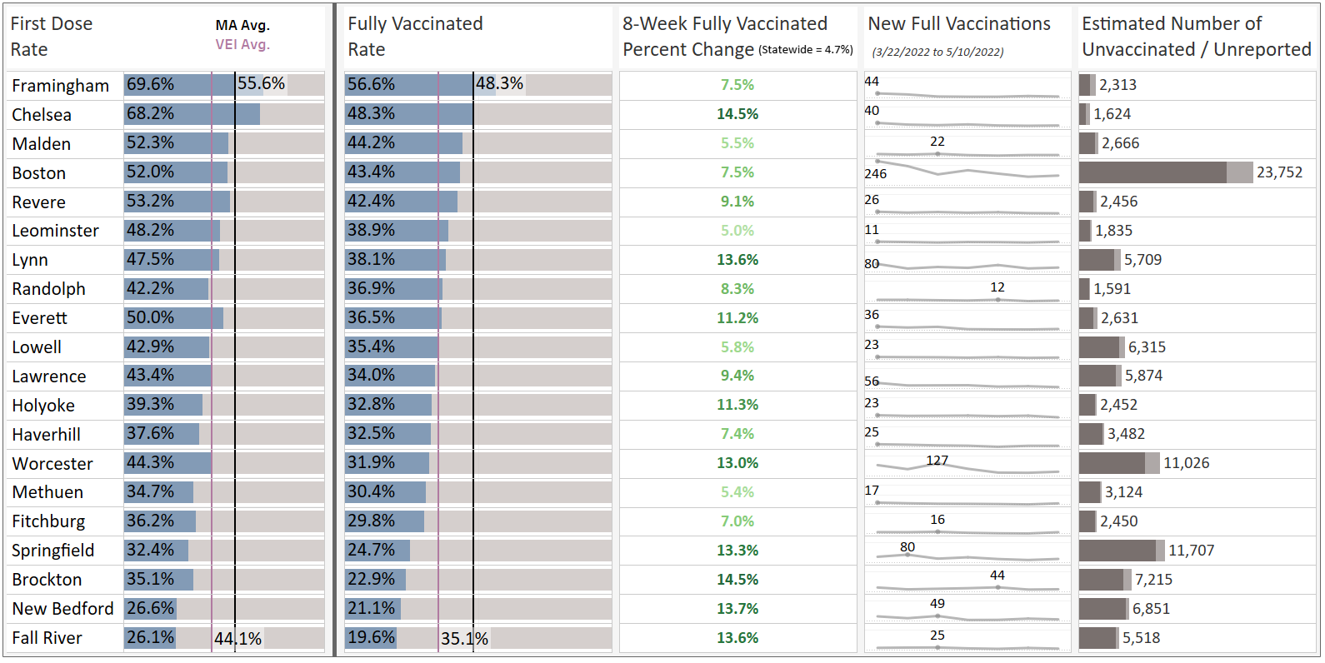
Pediatric (5-11 years old) Vaccination Rates in VEI Communities
Data Note
For the unvaccinated / unreported numbers, the darker gray represents individuals without a single dose and the lighter gray represents individuals without a full vaccination series.
Data from 5/11/2022

Slide 34
Family-Friendly April School Vacation Clinics
April school vacation week clinics were hosted by VEI at family-friendly businesses across the state and featured a variety of fun incentives and giveaways that appealed to kids and families. In total, 1,068 people were vaccinated at 43 clinics across 11 communities.
Those who got vaccinated at the April school vacation week clinics received giveaways like:
1 hour of free bouncing, skating, game play, or bowling
Free park or zoo admission for a child and companion
Free meal, snack, or ice cream
Gift cards to grocery stores or local restaurants
At the Six Flags clinic, those who got vaccinated received 2 free entry passes, free parking, and a free meal, valid through August 30.
34

Slide 35
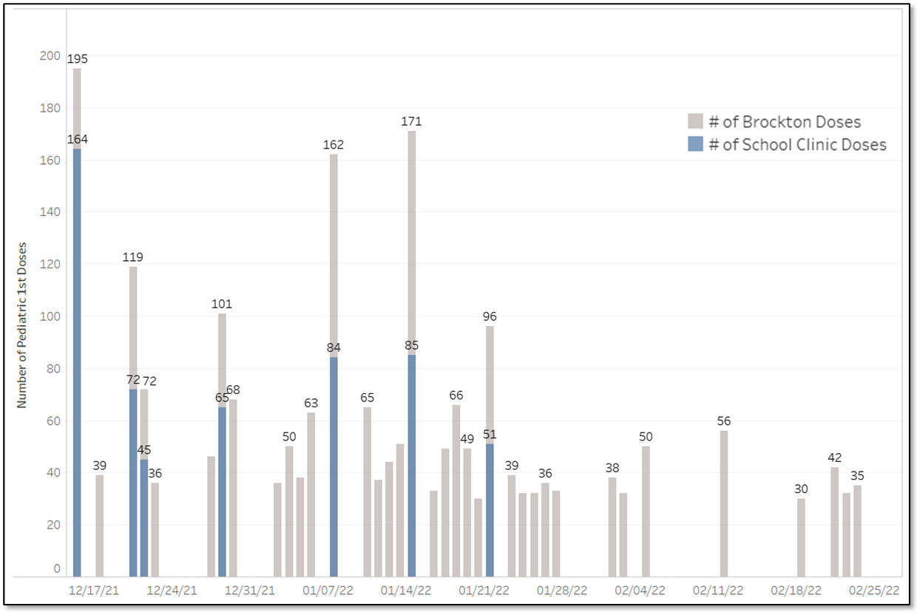
Daily 1st Dose Vaccines to Pediatric Populations within Brockton
Day of School Clinic | 12/16 | 12/21 | 12/22 | 12/29 | 1/8 | 1/15 | 1/22 | 2/5 | 2/12 | 2/19
% of Brockton 1st Doses | 84% | 61% | 63% | 64% | 52% | 50% | 53% | <30 daily doses* | 36% | 57%
The school & school-related clinics were responsible for:
A majority of Brockton’s daily 1st doses to pediatric populations on days the clinics occurred
24% of all 1st doses to pediatric populations during this time
Robocalls advertising the school clinics halted at the end of January, presumably leading to a decline in vaccination rates
Robocalls stopped on 1/31
School Clinic Day*
*Please note: days or clinics with less than 30 doses have been suppressed.

Slide 36
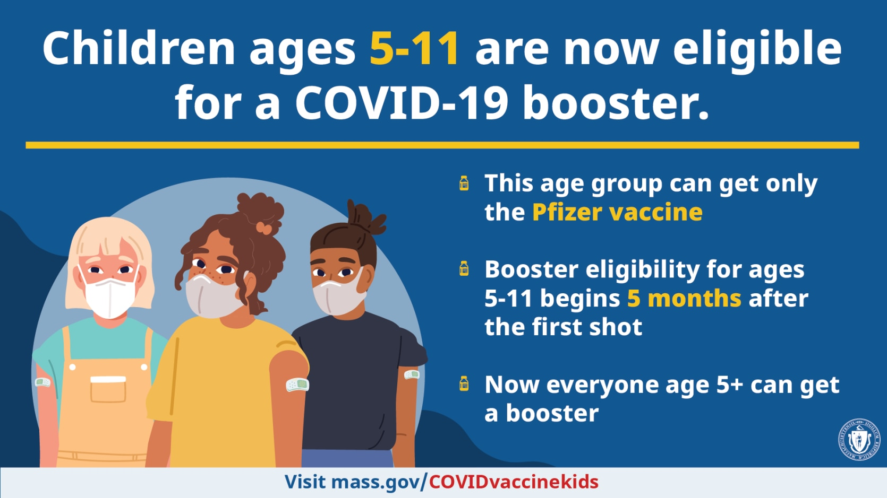
Opportunities to Support Family-Friendly Vaccine Clinics
Recommended Options for Schools:
Host vaccine clinic(s) before the end of the school year, during the summer, and/or
as a back-to-school event
Important for new pediatric boosters
How DPH Vaccine Equity Initiative can Help:
Coordinate every detail of the clinic
Scheduling clinicians
Providing supplies and incentives
Providing outreach materials

Slide 37
Opportunities to Support Family-Friendly Vaccine Clinics
Recommended Options for Schools:
Communicate about family-friendly clinics—many planned for spring and summer
Send community clinic information home with students via flyers
Send robocalls and texts to families with community clinic information
Share community clinic information via school/district email, social media, website, etc.
How DPH Vaccine Equity Initiative can help:
Facilitate promotion of family-friendly clinics
Design, print and deliver flyers
Write robocalls and texts to families in relevant languages for your school
Draft the content for your school/district email, social media, website, etc.

Slide 38
Opportunities to Support Family-Friendly Vaccine Clinics
Recommended Options for Schools:
Provide an opportunity for parents to opt-in to receiving help booking a vaccine appointment for their children/family
How DPH Vaccine Equity Initiative can Help:
Create communication tool to help families request support

Slide 39
Contact us
COVID-19 Communications Resources on Mass.gov
https://www.mass.gov/info-details/covid-19-vaccine-equity-initiative-communications-materials
Clinic request form
https://survey.jsi.com/s3/MA-Mobile-Vaccination-Clinic-Request-Form
Samantha Joseph
samantha.h.joseph@mass.gov

Slide 40
THANK YOU!
We are tremendously grateful for your diligence and resourcefulness over the last two years, including using our testing program as one of many important mitigation strategies to maintain in-person learning for our students.

