Slide 1
Spring 2023 MCAS Grade 10
Parent/Guardian Report Walk-Through

Slide 2
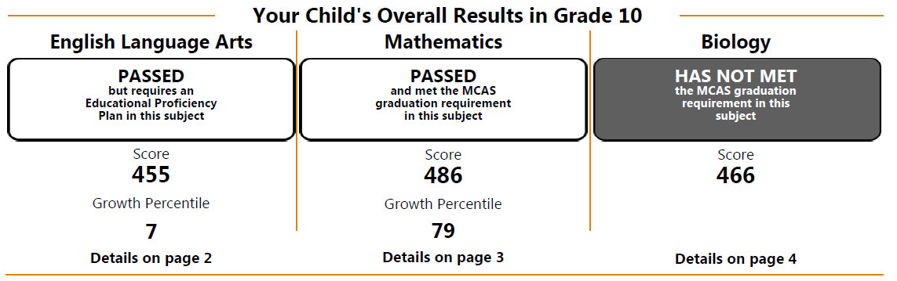
Overall Results: Page 1 of Parent/Guardian Report
This section shows the following information:
  whether your child Passed or Has Not Met the MCAS testing requirement for each subject
  whether your child requires an Educational Proficiency Plan
  your child’s scaled score for each subject and growth percentile in ELA and Mathematics
  Biology and Introductory Physics tests are reported on the next-generation scale, while the Chemistry and Technology/Engineering tests are reported on the legacy scale.

Slide 3
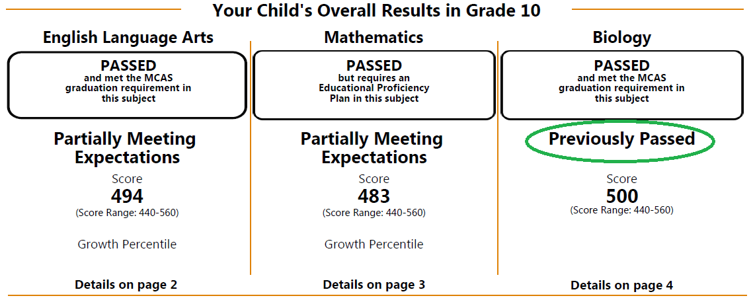
Results for the Science and Technology/Engineering Tests: Page 1
Students are eligible to take the STE subject tests in grade 9 or grade 10.
If your child previously took one of the STE subject tests in Biology, Chemistry, Introductory Physics, or Technology/ Engineering, their results will be reported as “Previously Passed” or “Previously Failed.”

Slide 4
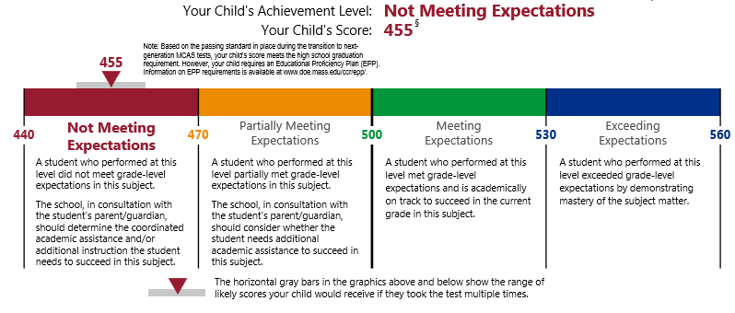
Results for Each Subject Test: Pages 2–4 of Report
This section shows your child’s score and achievement level in each subject and explains what each achievement level means.
For students in the class of 2025 and earlier, certain scores in the Not Meeting Expectations level (as in the example above) met the minimum score to earn the Competency Determination in ELA, Mathematics, and STE.
For students in the classes of 2026‒2030, certain scores in the Partially Meeting Expectations level meet the minimum score to earn the Competency Determination in ELA, Mathematics, and STE.
Additional details and graduation requirements are available at www.doe.mass.edu/mcas/graduation.html.

Slide 5
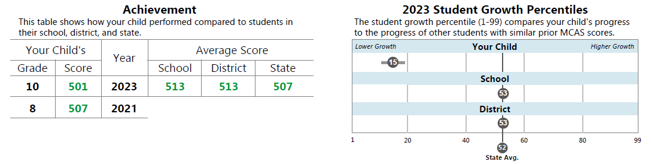
Achievement and Growth Percentiles: Pages 2 and 3 of Report
Achievement
Your child’s score this year
Your child’s score from previous years in the same subject
School, district, and state averages for comparison
Growth
Your child’s Growth Percentile (1-99)
A Growth Percentile of 15 means your child scored higher than 15% of the students with similar prior MCAS scores.
Scores from at least two consecutive-year tests are used to calculate Growth Percentiles.
School, district, and state averages for comparison

Slide 6
ELA and Mathematics Reporting Categories and Item Results: Pages 2 and 3
A table for each subject area shows the following information:
  the reporting categories for that subject
  the number of points your child earned out of the total possible points
  the average points earned by students in your child’s school and district
  the average points earned statewide by students who performed at or near a score of 500 (the low end of the Meeting Expectations achievement level)

Slide 7
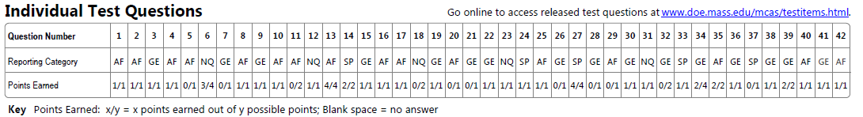
ELA and Mathematics Reporting Categories and Item Results: Pages 2 and 3 (cont’d)
The reporting category (middle row) can be used to identify areas where your child is succeeding and areas where they may need additional support.
The points earned (bottom row) shows how many points your child earned on each question of the test.
Released items are available at www.doe.mass.edu/mcas/testitems.html. DESE releases 100% of the test questions from the grade 10 ELA and Mathematics tests and from the high school Biology and Introductory Physics tests.

Slide 8
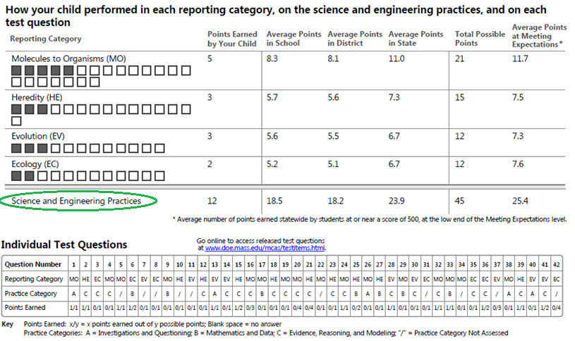
Biology and Introductory Physics Reporting Categories, Item Results, and Practice Categories: Page 4
Reports for students who took the High School Science test in Biology or Introductory Physics include Science Practices.
The Practice categories include (A) Investigations and Questioning; (B) Mathematics and Data; and (C) Evidence, Reasoning, and Modeling.
More information about the Practice categories is available at www.doe.mass.edu/mcas/tdd/practice-categories.html.

Slide 9
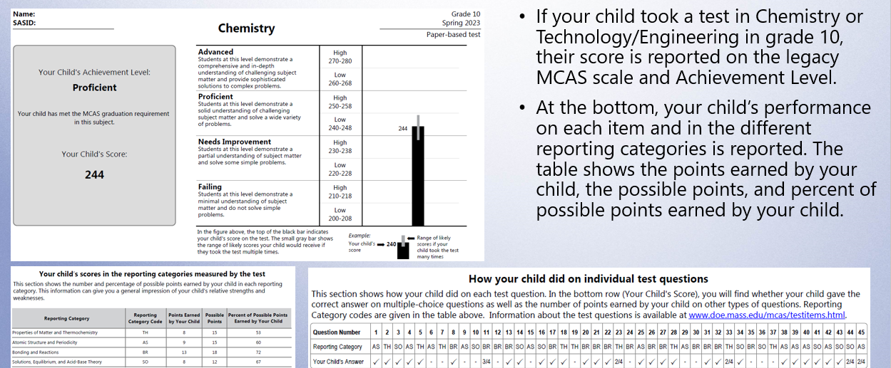
Legacy Chemistry and Technology/Engineering Reports: Page 4

Slide 10




THANK YOU
The Office of Student Assessment Services
781-338-3625
mcas@doe.mass.edu
www.doe.mass.edu/mcas
75 Pleasant Street, Malden, MA 02148

