Slide 1
The Massachusetts Seal of Biliteracy
Pat Marshall, Department of Higher Education
Andy McDonie, Department of Elementary and Secondary Education

Slide 2
Your hosts today
Department of Elementary and Secondary Education
Department of Higher Education
Andy McDonie, Language Acquisition Support Specialist – World Languages
Sibel Hughes, Assistant Director, Office of Language Acquisition
Pat Marshall, Deputy Commissioner for Academic Affairs and Student Success
Allison Little, Assistant Commissioner, P-16 Alignment and Outreach

Slide 3
Norms
Microphones: Please keep your microphones muted unless you are speaking
Chat: To help us curate your questions and contributions in an orderly way, and to minimize pop-up chat messages, please direct any questions to the Padlet. The link to the Padlet can be found in the chat box.
Note-taking: Please know that we will send you a copy of this slide deck and this recording afterward.

Slide 4
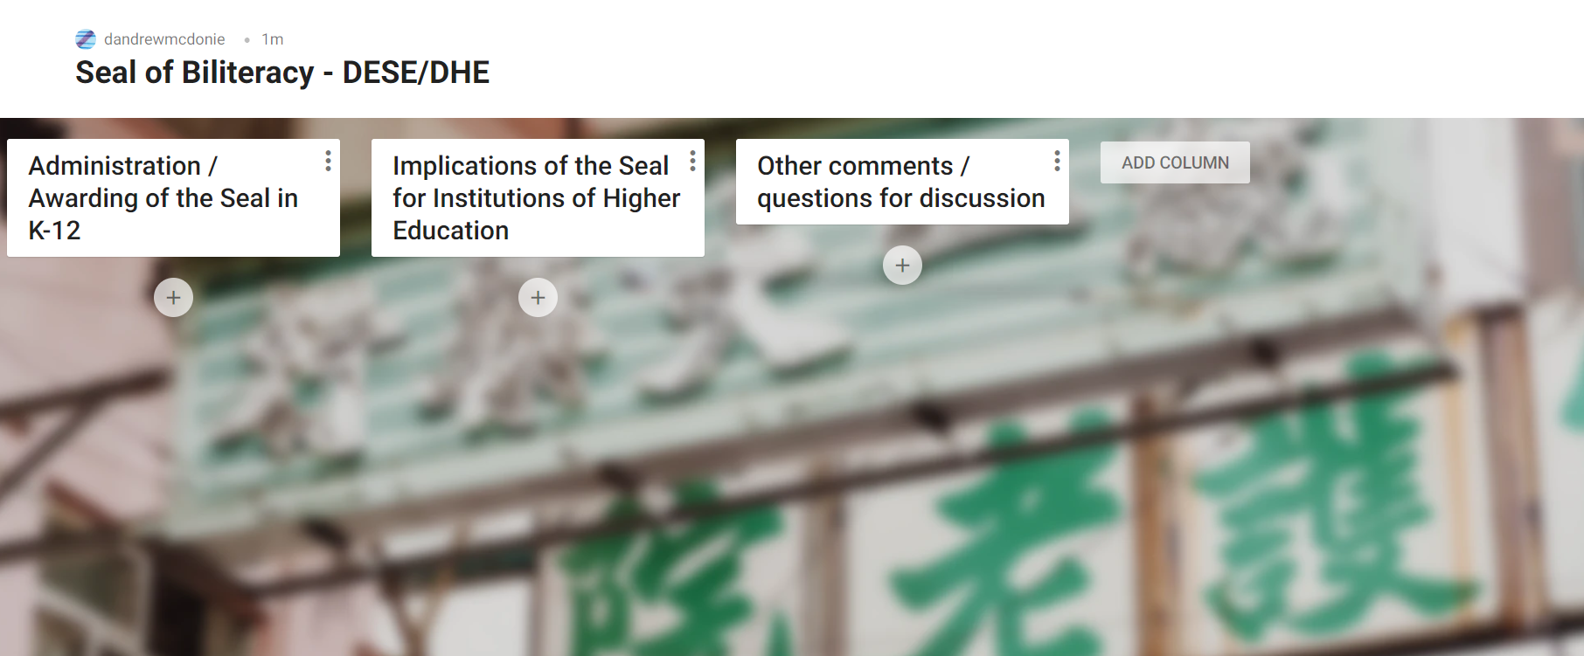
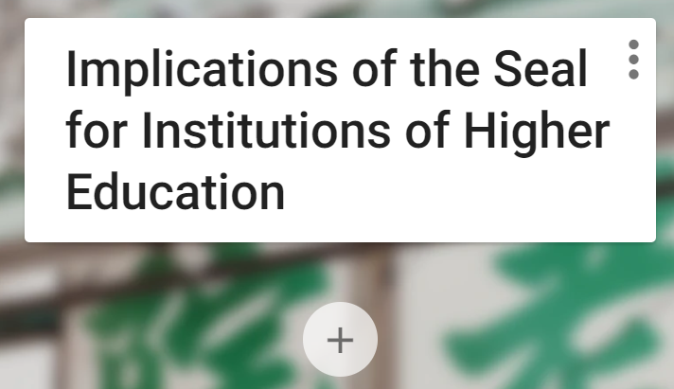
PADLET DISCUSSION BOARD
Add posts clicking on the + sign under the appropriate column
Changes are autosaved
Links, images, etc. can be added.
Notes:
https://padlet.com/dandrewmcdonie/mohy4xeycsg83yj1

Slide 5
Who are you?

Slide 6
CONTENTS
01
What is the Massachusetts Seal of Biliteracy?
02
Higher Education Connections
03
Discussion

Slide 7
The Massachusetts Seal of Biliteracy
01

Slide 8
How much do you already know about the Seal of Biliteracy?

Slide 9
What is the Seal of Biliteracy?
The State Seal of Biliteracy is a designation that provides a means to recognize high school graduates who attain high functional and academic levels of proficiency in English and a world language, meaning that those students can function in those languages in authentic, real-life situations.

Slide 10
How the Seal of Biliteracy came to Massachusetts
On November 22, 2017, Governor Baker signed into law “An Act Relative to Language Opportunity for Our Kids,” Chapter 138 of the Acts of 2017, commonly referred to as the LOOK Act. The State Seal of Biliteracy is a key element of the LOOK Act.
On June 26, 2018, the Board of Elementary and Secondary Education adopted regulations that describe the criteria that school districts must use to award the State Seal of Biliteracy.

Slide 11
How do students earn the Seal?
Meet all graduation requirements
1
Demonstrate high levels of proficiency in English
2
Demonstrate high levels of proficiency in a language other than English
3
Notes:
Challenge – reliably assessing levels of proficiency in languages other than English

Slide 12
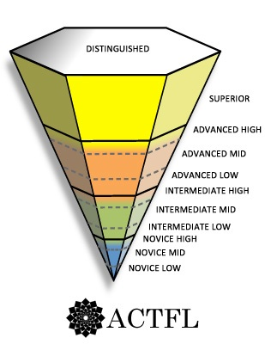
What can Seal-earning graduates do with the language?
Superior - Abstract language,
hypothetical conjectures
Advanced - Ordered descriptions, narratives,
resolutions (Storyteller)
Intermediate - Creative Sentences and
Questions (Survivor)
Novice - memorized words, phrases (Parrot)
Source: ACTFL Proficiency Guidelines (2012)
Notes:
Take this back to one of the challenges – We don’t know what to look for; WL students are not really learning the language, etc.
Professional skills begin to emerge at this level.
Poll: How long do you think it takes to gain X proficiency level
Poll: Where do you think the threshold for high functional proficiency for the Seal might be?

Slide 13
What can Seal-earning graduates do with the language? …
Superior - Abstract language,
hypothetical conjectures
Advanced - Ordered descriptions, narratives,
resolutions (Storyteller)
What level of proficiency should HS graduates demonstrate to earn the Seal of Biliteracy?
Intermediate - Creative Sentences and
Questions (Survivor)
Novice - memorized words, phrases (Parrot)
Source: ACTFL Proficiency Guidelines (2012)
Notes:
Take this back to one of the challenges – We don’t know what to look for; WL students are not really learning the language, etc.
Professional skills begin to emerge at this level.
Poll: How long do you think it takes to gain X proficiency level
Poll: Where do you think the threshold for high functional proficiency for the Seal might be?

Slide 14
What can Seal-earning graduates do with the language? .
Superior - Abstract language,
hypothetical conjectures
Advanced - Ordered descriptions, narratives,
resolutions (Storyteller)
Seal of Biliteracy
Intermediate - Creative Sentences and
Questions (Survivor)
Novice - memorized words, phrases (Parrot)
Source: ACTFL Proficiency Guidelines (2012)
Notes:
Take this back to one of the challenges – We don’t know what to look for; WL students are not really learning the language, etc.
Professional skills begin to emerge at this level.
Poll: How long do you think it takes to gain X proficiency level
Poll: Where do you think the threshold for high functional proficiency for the Seal might be?

Slide 15
What can Seal-earning graduates do with the language? ..
Superior - Abstract language,
hypothetical conjectures
Seal of Biliteracy with Distinction
Advanced - Ordered descriptions, narratives,
resolutions (Storyteller)
Intermediate - Creative Sentences and
Questions (Survivor)
Novice - memorized words, phrases (Parrot)
Source: ACTFL Proficiency Guidelines (2012)
Notes:
Take this back to one of the challenges – We don’t know what to look for; WL students are not really learning the language, etc.
DHE – Pull this slide forward w/AP scores

Slide 16
Students must demonstrate a proficiency level of Intermediate High to earn the Seal of Biliteracy.
Professional skills
Difficult to obtain in 6-12 programs
Notes:
Include a bit about AL and Seal w/Distinction

Slide 17
The intent of the State Seal of Biliteracy in K-12:
Encourage
Encourage students to study and master languages
Certify
Certify attainment of biliteracy skills
Recognize
Recognize the value of language diversity

Slide 18
What do students and families get out of the Seal?
College credits (at participating institutions of Higher Education)
Ability to put Massachusetts’ only legal recognition of biliteracy on resumes
Validation of home language as an asset

Slide 19
How many high school graduates have earned the Seal?
Notes:
Provide actual numbers

Slide 20
Questions from Padlet

Slide 21
Higher Education Connections
02
Notes:
Pat-Thanks Andy for the work DESE has done to support students with cultural and linguistic assets in K-12. Now is an opportune time to continue to support these students in higher education on their pathway to earning a degree or certificate.

Slide 22
The regulations describe that the purposes of the State Seal of Biliteracy in Higher Ed include:
Provide employers with a method of identifying people with language and biliteracy skills;
Provide universities with a method to recognize and give credit to applicants for the attainment of high-level skills in languages;
Prepare students with skills that will benefit them in the labor market and the global society; and
Strengthen intergroup communication and honor the multiple cultures and languages in a community.( State Regulation 603 CMR 31.01(3)).
Notes:
Why do we have a Seal?
Segue: We just heard about the SSOBL from DESE; the rationale behind regulations include connections to higher ed and workforce.
Pat-discusses the impact of the K-12 regulations on Higher Education. This helps to provide credibility and context of the work to IHEs.
Healthcare, early education, labor workforce connections.
Also add in here the equity agenda; focus on asset based or is it enough to discuss in the next slides coming

Slide 23
How many high school graduates have earned the Seal? ,,,
Notes:
How many students are impacted?
Segue: This many students in K-12 have earned the SSOBL in last two years. Huge jump!
Provide actual numbers
Pat-discusses how many high school students our institutions are potential receiving with this seal. This is a population who can help to support the world languages departments.
Increase number of students who are majors, double majors, or minors.
Encourage bilingual students to consider teaching as a career to better support K-12 student learning; DESE offers MTEL vouchers for students who have earned the seal.

Slide 24
In 2018-2019, 10.5% of all K-12 students were already proficient in a language other than English.
Notes:
There is the potential for many students to be coming in with the SSOBL. About 10% of all K-12 students have proficiency in a language other than English.

Slide 25
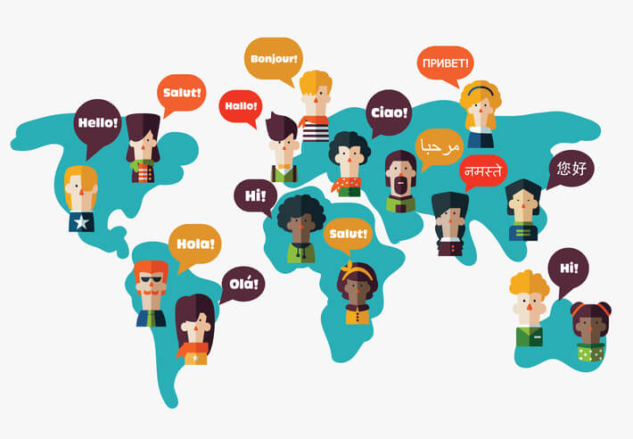
Valuing language through credits
New Undergraduate Experience Document
Language proficiency is an asset
The Seal promotes equity among students
Multiple ways to assess
Can support improved completion rates
Aligned with Prior Learning Assessment (PLA)
Notes:
How does this connect to work we are already doing in higher education?
Segue: The SSBOL supports our higher ed systemic goals of equity, supporting high demand labor workforce skills, and improving completion rates.
Pat-The NUE document that the department is updating for the first time since 1989 focuses on valuing a student’s language, culture, and lived experiences as assets that they bring to their institution and education. The State Seal of Biliteracy that the Department of Elementary and Education created is a designation that can signal to higher education institutions a level of proficiency that is an asset that students bring with them upon entry. This seal is earned through multiple assessment measures and helps to promote broader equity beyond AP, IB, or CLEP. Providing students with college credit for this designation also can help to improve equitable completion outcomes for students.

Slide 26
For which experiences does your campus currently issue PLA credits? (check all that apply)
Notes:
We have used the term PLA a few times. Let’s take a read on how much people know and have been involved with PLA previously. – Clean this slide up

Slide 27
Prior Learning Assessment
Credits colleges issue to students for skills and knowledge learned outside of the classroom
Similar to AP, IB, CLEP
Boosts retention and completion for English Language Learners and adult learners
Up to 2.5x more likely to graduate (Klein-Collins, 2010)
Saves time and money
Examples
Health sciences
Early Education
Military Service
Notes:
Segue: We have a “insert what the poll findings are—diverse group, a novice group, an experienced group” group attending. Let’s review PLA though to help everyone to be on the same page.
What is PLA?
We are already doing this for students when we give them credits for AP, IB, CLEP.
SSOBL provides broader access to earning college credit prior to matriculation than those other programs. SSOBL is assessed via portfolio, oral exam, written exam. It doesn’t just assume there is one way to assess knowledge. Those who earn PLA credits are 2.5x more likely to graduate with a degree. Also saves students time and money, as well as puts them on a pathway to a minor or major in a world language.
Language is a skill that is recognized in the workplace, which is recognized in the regulations.
We have done similar issuing of PLA credits for prior work in health sciences, early education, and service in the military.
Also want to mention that the DHE has been supportive of this through the PLA consortium for the 15 community colleges that was supported through PIF/HEIF (this starts to build the link to the last slide on how DHE can support this work)

Slide 28
What can Seal-earning graduates do with the language? …..
Superior - Abstract language,
hypothetical conjectures
Advanced - Ordered descriptions, narratives,
resolutions (Storyteller)
Seal of Biliteracy
Intermediate - Creative Sentences and
Questions (Survivor)
Novice - memorized words, phrases (Parrot)
Source: ACTFL Proficiency Guidelines (2012)
Notes:
Take this back to one of the challenges – We don’t know what to look for; WL students are not really learning the language, etc.
Professional skills begin to emerge at this level.
Poll: How long do you think it takes to gain X proficiency level
Poll: Where do you think the threshold for high functional proficiency for the Seal might be?

Slide 29
What can Seal-earning graduates do with the language? …….
Superior - Abstract language,
hypothetical conjectures
Advanced - Ordered descriptions, narratives,
resolutions (Storyteller)
What level of proficiency do students with AP scores of 3+ demonstrate?
Intermediate - Creative Sentences and
Questions (Survivor)
Novice - memorized words, phrases (Parrot)
Source: ACTFL Proficiency Guidelines (2012)
Notes:
Take this back to one of the challenges – We don’t know what to look for; WL students are not really learning the language, etc.
Professional skills begin to emerge at this level.
Poll: How long do you think it takes to gain X proficiency level
Poll: Where do you think the threshold for high functional proficiency for the Seal might be?

Slide 30
What can Seal-earning graduates do with the language? ,
Superior - Abstract language,
hypothetical conjectures
AP
Advanced - Ordered descriptions, narratives,
resolutions (Storyteller)
5
Seal of Biliteracy
4
3
Intermediate - Creative Sentences and
Questions (Survivor)
Novice - memorized words, phrases (Parrot)
Source: ACTFL Proficiency Guidelines (2012)
Notes:
Segue: Crosswalk what they are familiar with (AP) with SSOBL
Why should we issue credits for SSOBL?
We already do this. We are connecting this to what you already do with AP.
A 3 in AP converts to Intermediate Mid
A 4 is Intermediate High
A 5 is Advanced Low

Slide 31
Equity: The Seal of Biliteracy provides broad access for speakers/signers of all languages.
Districts offer the opportunity to all eligible students in the district.
Districts inform all families in the district of the opportunity to earn the Seal.
Districts offer the Seal for all human languages
Notes:
Segue: We already do this in AP and other areas; SSOBL is another type to add more tools to their toolkits for providing credit to students. - Fix the colors on this
We already accept AP. This is as or more rigorous than AP, but it provides greater access and more languages.
AP (and other PLAs) is our runway. We already know how to do this. Let’s provide greater access to students by accepting the Seals.

Slide 32
Some IHEs are already granting credit for the Seal.
Salem State University
Middlesex Community College

Slide 33
Salem State University
Seal of Biliteracy (Intermediate High) get 6 credits (201 and 202)
Seal of Biliteracy with Distinction (Advanced Low) get 9 credits (201, 202 and 300 level)

Slide 34
Middlesex Community College (policy under consideration)
12 credits (4 semesters at 3 credits each) of a world language if MCC offers 4 semesters of that language
12 credits (4 semesters at 3 credits each) of Humanities credits if MCC does not offer that language.

Slide 35
Higher Education Innovation Fund (HEIF)
Opportunity for public higher education institutions to develop new programs and strategies
Focus on equity
PLA strand
Competitive proposals will be designed to make recommendations to inform the public higher education system
Proposals due January 15
Notes:
Segue: We want to support you in this work. One of the ways for us to support you is through HEIF.
How can the DHE support you in this work?

Slide 36
Discussion
03

Slide 37
Discussion Questions (On Padlet)
What do you see as the greatest advantages to awarding credit for the Seal of Biliteracy?
What do you see as the greatest challenges to implementing this change in your institution?
What are some steps your institution could take right now to begin awarding credit to Seal recipients?

Slide 38
Follow the link in the chat to respond to this question.
Notes:
https://www.menti.com/8wuccjdicy

Slide 39
Follow the link in the chat to respond to this question. .
Notes:
https://www.menti.com/8wuccjdicy

Slide 40
THANK YOU
Andy McDonie
World Language Acquisition Support Specialist, DESE
Patricia Marshall
Deputy Commissioner for Academic Affairs and Student Success, DHE
Email: d.andrew.mcdonie@mass.gov
Website: www.doe.mass.edu
Email: pmarshall@dhe.mass.edu
Website: www.mass.edu
Notes:
Add Pat’s contact information here, too.
Email: pmarshall@dhe.mass.edu
Website: www.mass.edu
Address: 1 Ashburton Place, Suite 1401, Boston, MA 02108
Phone: 617-994-6939

Slide 41
Post Survey
How enthusiastic do you feel about exploring how to provide credit for SSOBL students on your campus?
Notes:
Segue: We hope that you are beginning to think about what this may mean for your students and how you can support them…

Slide 42
Why is the Seal of Biliteracy Important?
01

Slide 43
In 2018-2019, 10.5% of all students were English Learners.

Slide 44
Social Justice
Language comprises students’ identities, but this fundamental characteristic is often ignored.

Slide 45
What challenges face districts in recognizing linguistic assets?
For English Learners
For World Language learners
Unsure how to certify proficiency
Fear that focus on home language could interfere with English acquisition
Home languages not prioritized (testing/funding)
English superiority/White supremacy
Bad experiences with World Languages
World Languages are not prioritized (testing/funding).
World Languages start late in many districts.
Unsure how to certify proficiency
English superiority

Slide 46
The regulations describe that the purposes of the State Seal of Biliteracy are to:
Encourage students to study and master languages;
Certify attainment of biliteracy skills;
Recognize the value of language diversity;
Provide employers with a method of identifying people with language and biliteracy skills;
Provide universities with a method to recognize and give credit to applicants for the attainment of high-level skills in languages;
Prepare students with skills that will benefit them in the labor market and the global society; and
Strengthen intergroup communication and honor the multiple cultures and languages in a community.( State Regulation 603 CMR 31.01(3)).

Slide 47
The Seal of Biliteracy in Massachusetts
03

Slide 48
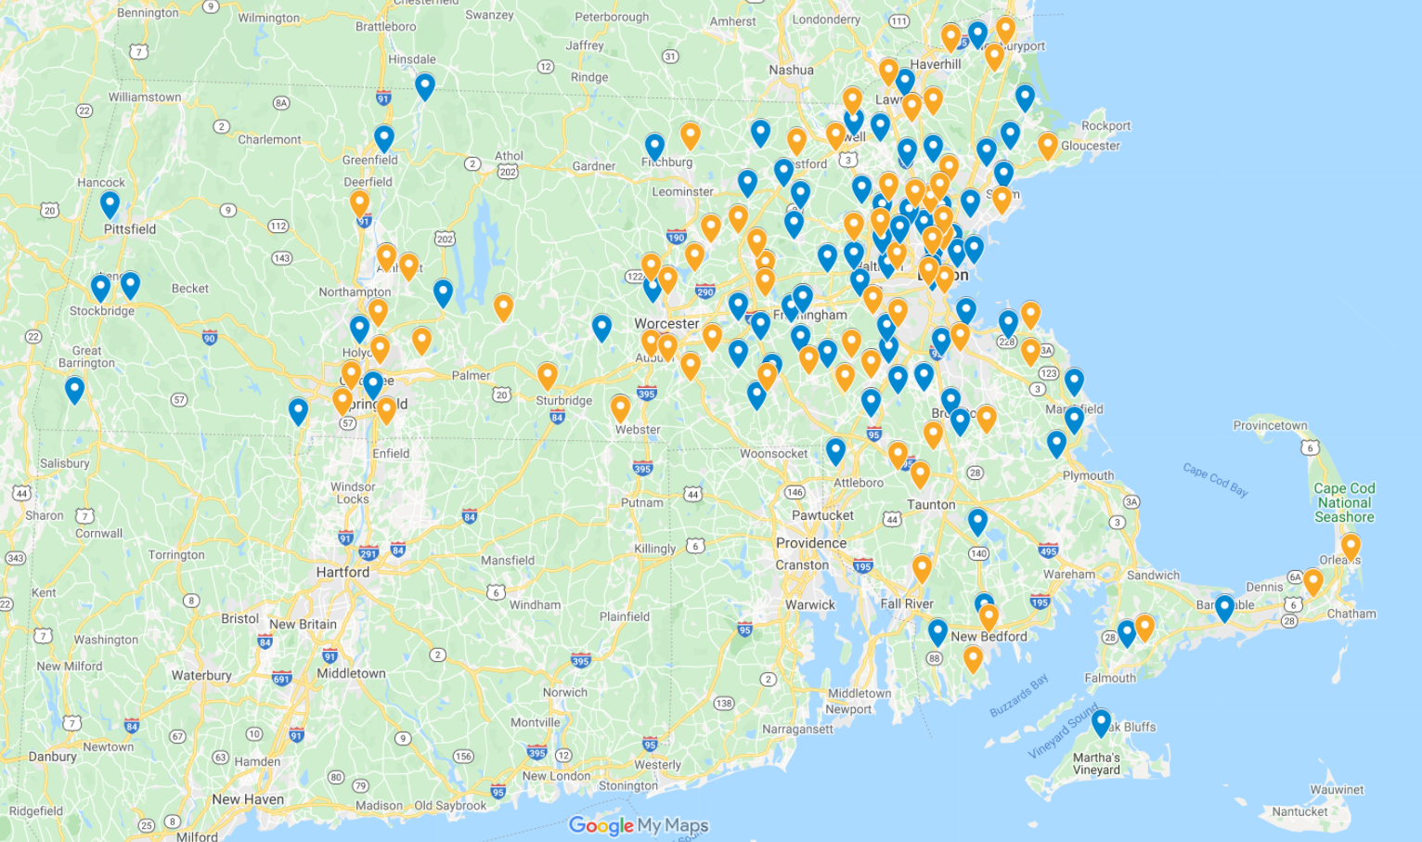
map

Slide 49
Number of Participating Districts

Slide 50
Number of Districts that awarded the Seal

