Slide 1





Student Opportunity Act 2021-22 Plan Amendment Overview Webinar

Slide 2





Welcome & Opening
SOA Commitments and Updates
Evidence-Based Programs Revisions
The SOA Plan Amendment Template
05
Timeline, Questions & Next steps
Notes:
David: Good afternoon. Welcome to this SOA Overview webinar. Thank you for joining us after our postponement. My name is David Parker. I’m the Manager of Regional Assistance for the Department.
Karen: And I’m Karen Johnston, the Coordinator of Regional Assistance for DESE. We appreciate that you are joining us here today, in the midst of a very busy and challenging year. Before we get started we just want to express our gratitude, which is shared by all of us at DESE, for the tremendous work you are doing on behalf of students during this 3rd school year that’s being impacted by the pandemic. David and I and the rest of our team are here to support you with any needs that arise as you engage in the SOA amendment process, so please don't hesitate to reach out with any questions after this webinar.
David: Here’s what we’ll be talking about today. We will start with a quick refresher, and then mostly we want to highlight what’s been updated this year and how to proceed through the amendment process.

Slide 3

A Message from Commissioner Riley
Notes:
We’ll begin with a message from Commissioner Riley. He is, of course, vitally interested in this work, and though he’s not available to attend these four overview webinars he wanted to have the opportunity to share some thoughts with you.
[Click on photo of Commissioner Riley while in Slide Show mode to access YouTube link].

Slide 4
Welcome & Opening
SOA Commitments and Updates
Evidence-Based Programs Revisions
The SOA Plan Amendment Template
05
Timeline, Questions & Next steps

Slide 5
AN ACT RELATIVE TO EDUCATIONAL OPPORTUNITY FOR STUDENTS
(aka The Student Opportunity Act, Chapter 132 of the Acts of 2019)
A key goal: narrow opportunity gaps in learning experiences, student achievement, and post-secondary outcomes for student groups
    Aligned to Commissioner Riley’s goals in Our Way Forward and goals of ESSER
Funding approaches and supports for addressing inequities
    Revises the chapter 70 funding formula to address inequities in how funds are allocated
    Substantial commitment to increasing chapter 70 funding to support K-12 education
Legislative expectations: funding will contribute to progress in closing gaps
    Districts develop, fund, and implement 3-year gap-closing plans that incorporate evidence-based practices
    DESE develops plan guidance & templates, sets targets, collects, reviews and posts plans
    Districts track their own progress in closing identified gaps; DESE tracks aggregate progress in closings gaps and submits annual reports to the legislature
Notes:
We want to take just a moment to revisit the original SOA legislation and its context.
A key goal of the Student Opportunity Act is to narrow opportunity gaps in the learning experiences of student groups, in particular for those students who have not historically been well-served by the education system. These kinds of opportunity gaps contribute to differences we see in student engagement, students’ academic self-perceptions, student achievement and postsecondary and lifetime outcomes.
This goal is strongly aligned to Commissioner Riley’s goals in Our Way Forward and goals of ESSER
Funding approaches and supports for addressing inequities
The state legislature not only revised the Chapter 70 funding formula to address inequities in how funds are allocated to districts, it also made a substantial commitment to increasing Chapter 70 funding to support K-12 education –and expects to phase in well over $1 billion and a half in additional funding over the next 6-7 years.
Legislative expectations: The legislature expects this major investment in education to contribute to measurable progress in closing opportunity gaps
Legislation lays out the following expectations for DESE and districts:
Districts develop, fund, and implement 3-year gap-closing plans that incorporate evidence-based practices and provide annual reports on progress and program amendments to DESE
DESE develops plan guidance & templates, sets targets, and collects, reviews and posts plans
Districts track their own progress in closing identified gaps; DESE tracks aggregate progress in closings gaps and submits annual reports to the legislature
A fair number of short form districts, particularly those receiving very modest increases in additional Chapter 70 aid through the new funding formula, have reached out to us to ask us whether they are expected to develop and implement 3-year plans. The answer is yes. At the policy level, the SOA legislation charges DESE, and every district and school in the state with working to close gaps in learning opportunities and outcomes for our students of color, students with disabilities, English learners, and students from economically-disadvantaged communities.
While Massachusetts continues to lead the nation in outcomes on some achievement measures for students overall, we don’t measure up nearly as well when our state data are disaggregated to look at the types of learning experiences and learning environments we are providing to the student groups I just mentioned-- nor do we measure up when we look at their student achievement and postsecondary outcomes. It’s our shared work to be intentional about closing these gaps in the coming years, while also continuing our efforts to improve educational experiences and outcomes for all of our students.
We have worked to make the amendment process as simple and easy for you as we can, while also recognizing that with this volume of funds being committed both through additional Chapter 70 funding and through Federal ESSER funding, we do have federal and state expectations placed on us to share how we're using the money

Slide 6
Student Opportunity Commitments
The Department has established a planning process that asks each district to make 4 “Student Opportunity Commitments” in order to close opportunity and achievement gaps among student subgroups:
Intentionally focus on student groups who are not achieving at the same high levels as their peers;
Adopt, deepen or continue specific evidence-based programs to close opportunity and achievement gaps for student subgroups and allocate resources to support these programs;
Monitor success in reducing disparities in achievement among student subgroups over three years with a small number of metrics and targets; and
Engage families, particularly those families representing student subgroups most in need of support, about how best to meet their students’ needs.
Notes:
Those of you who were involved in the development of your district’s original SOA plan will recognize these four commitments that were the framework of the plan template. The focus on historically underserved student groups continues to be the priority, improving outcomes through implementation of evidence-based programs.
The SOA legislation includes a component of monitoring for success: keeping track of your evidence-based programs to ensure that they’re well implemented and are meeting your goals.
And SOA continues to include a strong emphasis on family, community and stakeholder engagement. We’ve been hearing on a regular basis from stakeholders across the commonwealth that they’re very supportive of this work and eager to be involved in its design and its success.

Slide 7

So much has changed since we started SOA planning …
The pandemic
Plans began to be developed before Covid 19 struck
Year 1 was extended multiple times to encompass 2 years,
  SOA Chapter 70 increases didn’t happen in 2020-21, but are available for the 2021-22 school year
ESSER funds have come into play
We encourage districts to use this as an opportunity to rethink plans in light of new circumstances and new funding
Notes:
The Student Opportunity Act legislation was passed in November 2019. Districts had just been introduced to the SOA plan expectations when the pandemic arrived in full force and districts and schools shifted entirely to remote learning. Due to the uncertainty of the pandemic, the FY21 state budget did not include Phase I of additional Chapter 70 funding; the deadline for submitting original plans shifted multiple times – from April 2020 to January 2021. And although implementation Year 1 for SOA plans was originally slated to end in June 2021, DESE has stretched implementation Year 1 so that it technically ends at the end of this school year instead.
We have heard from you all that you and your schools continue to feel overwhelmed as you address the ongoing impacts of the pandemic. At the same time, we are heartened to hear districts and schools talk about the strategic ways in which they are addressing those challenges. We want to echo the Commissioner’s call to use evidence-based programs to help close opportunity and outcome gaps for our students.
The SOA amendment process can serve as a timely opportunity to reconsider your original plans in light of new circumstances and new funding. Your district’s priorities may have shifted based on what you have learned about students’ needs during the pandemic. Your district may be receiving enough additional funding through chapter 70 and ESSER to consider adding strategies you didn’t include in your original plan – or may permit you to scale up and deepen the implementation of evidence-based strategies beyond what you were able to do in your original plan.

Slide 8
Making the adjustments for 2021-22 …
Making the reflection and revision process for your plan as light a lift as possible
Expanding the Evidence-Based Program recommendations to align with ESSER guidelines
Recognizing that districts have already begun implementing their SOA plans, adding questions about the implementation progress
Notes:
While the reflection and revision process is a serious and important scope of work, we’ve streamlined the process to be as user-friendly as possible. We’ve created some alignment with ESSER guidelines for the sake of consistency. And we’ve added questions about where districts are in the implementation of their evidence-based programs to give us, and all stakeholders, a better grasp of progress.

Slide 9
When revisiting your original SOA plan …
Reengage your stakeholders around changing student needs and new opportunities
Reexamine programs: Are these still the most important things to be working on?
Be attentive to coherence across funding streams
Continue to focus on a few key areas to close opportunity gaps
  Adopt, deepen or continue your evidence-based programs
Notes:
We recommend that when you begin your plan amendment, that you continue engaging with your key stakeholders. Especially with all that’s happened since SOA planning first began two years ago, it’s essential to understand the needs, concerns and aspirations of students and families.
Then take another look at the evidence-based programs. Are these still your highest priorities? No matter how thoughtfully they were selected they may or may not be the most important things to focus on in this moment.
And always, it’s better to do a few things well. As you submit your plan amendment, remember that you have the options to adopt new programs, deepen those already in place, or continue programs that are demonstrating success.

Slide 10
Welcome & Opening
SOA Commitments and Updates
Evidence-Based Programs Revisions
The SOA Plan Amendment Template
05
Timeline, Questions & Next steps

Slide 11
New and Revised/Expanded Evidence-Based Program Areas
New Evidence-Based Program Areas:
Culturally responsive teaching and other strategies that create equitable and culturally responsive learning environments for students
English Learner Education programs, including dual language (DL) and transitional bilingual education (TBE) programs
Reconfigured Evidence-Based Program Areas
Expanded learning time for all students in the form of a longer school day or school year
Increasing opportunities for educators and support staff to engage in a cycle of continuous improvement, utilizing district and school teaming structures
Increasing opportunities for all students to engage in arts, enrichment, world languages, athletics, and elective courses
Developing effective family/school partnerships
Notes:
This year we are adding some program areas that were included in ESSER III applications that we thought were important to include. We have also, separated some categories that were combined last year into distinct categories, and we have substantially expanded one category that was very narrowly focused .
Two that you may recognize from the ESSER III applications are the new evidence-based program areas that you see in green text. These are:
Culturally responsive teaching and other strategies that create equitable and culturally responsive learning environments for students, and
Language support programs, including dual language (DL) and transitional bilingual education (TBE) programs
We see these as important additions. The culturally responsive teaching and other strategies program area is particularly germane to SOA plans, as we challenge ourselves as a state and at the district and school level to close gaps in learning experiences for students from historically underserved populations. The second elevates the important role of asset-based language support programs, particularly for our students who are English learners.
Moving on to reconfigured evidence-based program areas:
Expanded learning time for students was included in the original SOA legislation. Key building blocks of ELT programs were pulled apart and incorporated into several different evidence-based program areas last year; we opted to give it its own category this year.
The next two program areas –were combined into a single category last year. We opted to separate them because each has its own independent evidence-base and serve different functions
Well-implemented teaming structures play a key role at the district, school and teacher/support team level in building collaborative environments that use the continuous cycle of improvement to do things like improve instruction, monitor and support the implementation of strategies/curriculum, support distributed leadership in districts and schools
Arts, enrichment, languages, athletics, and elective courses are often the first courses to get cut when budgets are tight or when a school shows up as a school in need of targeted/focused support in DESE’s accountability system. These types of cuts disproportionally impact students of color, English learners, and students living in economically distressed communities – and there is a research and evidence base that demonstrates meaningful positive impacts on students’ social emotional learning, academic achievement, and art learning
The Developing effective family-school partnerships program area dramatically expands what was a relatively narrow focus on developing home school relationships through parent/teacher visiting programs. We know many districts are focusing on these kinds of partnerships and wanted to expanded it so that we could capture the many other important kinds of partnering that are going on.

Slide 12
Evidence-based programs: 21 examples of high-quality programs
Enhanced Core Instruction
Expanded access to full-day, high-quality pre-kindergarten for 4-year-olds, including potential collaboration with other local providers
Research-based early literacy programs in pre-kindergarten and early elementary grades
Early College programs focused primarily on students under-represented in higher education
Supporting educators to implement high-quality, aligned curriculum
Expanded access to career-technical education, including “After Dark” district-vocational partnerships and innovation pathways reflecting local labor market priorities
Culturally responsive teaching and other strategies that create equitable and culturally responsive learning environments for students.
Expanded learning time for all students in the form of a longer school day or school year
Notes:
The next three slides list all 21 of the evidence-based program areas. I won’t read through all of them now, but we did want you to see that evidence-based program areas continue to be organized in four broad areas: Enhanced Core Instruction

Slide 13
Evidence-based programs: 21 examples of high-quality programs (cont.)
Targeted Student Supports
Talent Development
Inclusion/co-teaching for students with disabilities and English learners
Language support programs, including dual language and transitional Bilingual education programs (TBE)
Acceleration Academies and/or summer learning to support skill development and accelerate advanced learners
Dropout prevention and recovery programs
Diversifying the educator/administrator workforce through recruitment and retention
Leadership pipeline development programs for schools
Strategies to recruit and retain educators/ administrators in hard-to-staff schools and positions
Increasing opportunities for educators and support staff to engage in a cycle of continuous improvement, utilizing district and school teaming structures
Notes:
Targeted Student Supports, and Talent Development

Slide 14
Evidence-based programs: 21 examples of high-quality programs (cont.)
Conditions for Student Success
Expanding capacity to address SEL and mental health needs of students/families
Increasing opportunities for all students to engage in arts, enrichment, world languages, athletics, and elective courses
Developing effective family/school partnerships
Community partnerships for in-school enrichment and wraparound services
Labor-management partnerships to improve student performance
Facilities improvements to create healthy and safe school environments
The above evidence-based programs correspond to the program categories outlined in the SOA legislation.
Notes:
and Conditions for Student Success.
While we’re on this slide, I do want to mention that we changed the name of one program area – last year number 16 was known as: Increased personnel and services to support holistic student needs; this year it’s been renamed Expanding capacity to address social emotional learning and mental health needs of students and families to reflect the elevated focus on social emotional learning and mental health needs of students and families since the pandemic started.
The full list of evidence-based practice areas, organized by category, appears at the beginning of the SOA guidance document for developing and submitting SOA plans and at the beginning of the SOA evidence-based program description resource, both of which are posted on our SOA District Resources page. This resource includes a 1-2 page summary for each evidence-based program area that highlights the evidence-base, high quality program components and/or implementation considerations, and contact information for who you can reach out to at DESE if you have any questions.

Slide 15
Welcome & Opening
SOA Commitments and Updates
Evidence-Based Programs Revisions
The SOA Plan Amendment Template
05
Timeline, Questions & Next steps
Notes:
Now we’ll look at some features of this year’s plan amendment template. A link to the template with login information was sent to superintendents on December 10.

Slide 16
Streamlining SOA Plan Application Process
The 2021-22 SOA Plan Amendment Template
Prepopulated with relevant data
  Disaggregated district-level student data
  The student groups districts identified in original SOA plans
  The evidence-based program areas identified in original SOA plans
  Last year’s SOA narrative for some sections
  Districts’ ESSER and Chapter 70 (increase) funds
Notes:
We’ve designed the plan amendment template to streamline the submission process. We’ve incorporated disaggregated data from each district into the template to get the process started. All data in the template is public data, but we’re putting it at your fingertips for your convenience. We’re listing the student groups you selected in your original plan, and the evidence-based programs you identified as your opportunity gap-closing measures. Where it was possible, we’ve included narrative portions of your original plan, which you can edit as appropriate or leave as-is. Finally, we’ve listed the district’s ESSER allocation and Chapter 70 increase amount for this year so you have those numbers readily available.
Long form districts will be pleased to know that all of your budget information can be submitted right into the template, so you won’t need to submit an additional budget form.
It may be helpful for you to know that if you don’t complete your amendment entries in a single sitting, you’ll be able to go back in later to pick up where you left off. You can save your progress by clicking the “Save and continue later” feature that appears at the top right of every page.

Slide 17
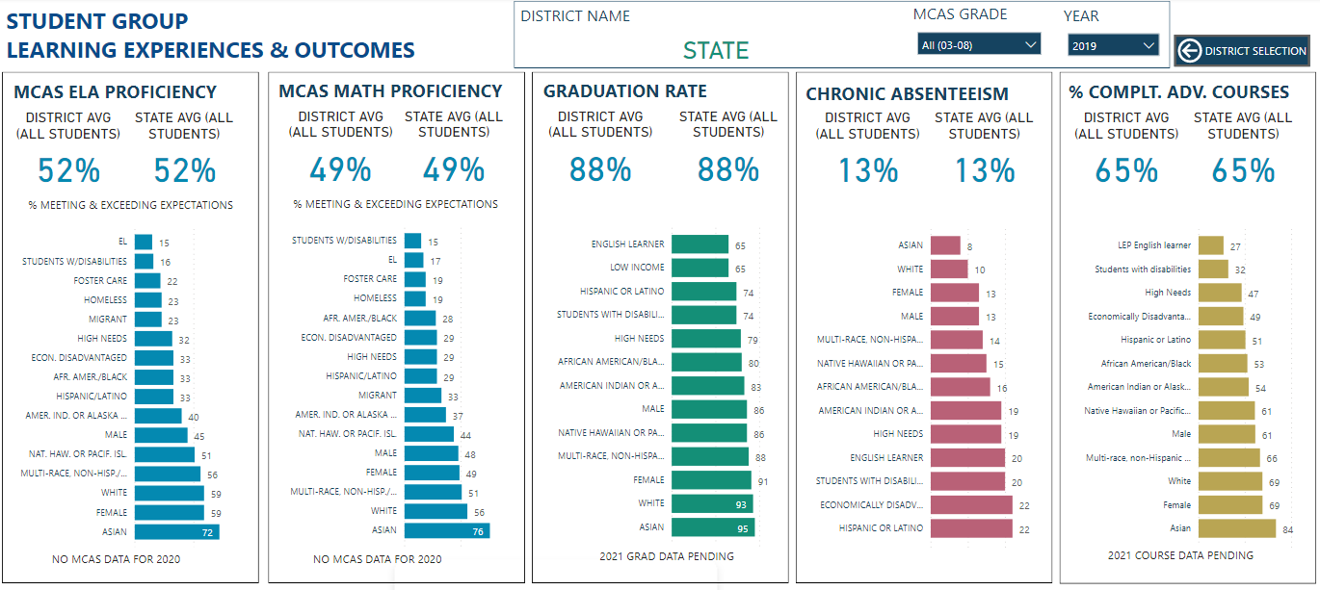
Prepopulating plans with disaggregated student data
Notes:
Let’s take a look at some screenshots from the template. Here you see the data display with percentages of MCAS proficiency, graduation rate, chronic absenteeism and advanced course completion by student groups. Notice that under the MCAS and Year headings are dropdown menus. These will function right in the template to allow you to look across multiple years and grade levels. I want to note that some data is not available for every year, so if something seems to be missing it’s likely because it hasn’t been collected or published for that year.

Slide 18
Changes to budget data
Last year:
  How did your district spend your additional chapter 70 funds to support selected evidence-based program areas?
  Minimum spending targets were set for the amount of additional chapter 70 funding amounts long districts should apply towards gap-closing measures
This year:
  What investments are you making in selected evidence-based program areas and how are you braiding different funding sources to support them?
  Districts are anticipated to use multiple funding sources to close opportunity gaps
Notes:
This year we have made a key change to how we ask districts provide budget information on how they are funding the Evidence-Based Practices in their plans in order to make it more consistent with what the legislation calls for.
Last year the budget tables essentially asked districts to focus on how they planned to use additional Chapter 70 funds to support selected evidence-based practices.
This unintentionally left some districts with the impression that they only needed to tell us how additional chapter 70 funding was being spent. This left some districts treating their plans and budgets more like a grant.
We compounded this misconception for long form districts by setting minimum targets for what proportion of additional funds should be spend on evidence-based program areas.
Although the written guidance instructed districts to provide additional information in their narratives about how other funding streams would support implementation, that message was missed by many districts.
This year districts are being more explicitly asked:
What investments are you making in selected evidence-based program areas –and how are you braiding different funding sources to support them? This is consistent with what the SOA Legislation calls for districts to include in their plans.
It gives the state legislature, those of us at DESE, and other stakeholders us a much better window into what level of financial resources it takes for districts to fund high-quality implement of the types of evidence-based program areas in their plans.
And one last important point before I turn the Webinar back over to David. The budget tables in the template are asking for FY22 budget information. It focuses on what you project you will spend to support the implementation of the evidence-based program area through the end of the state fiscal year. We’re already halfway through the year, so hopefully this will help in making those projections.

Slide 19
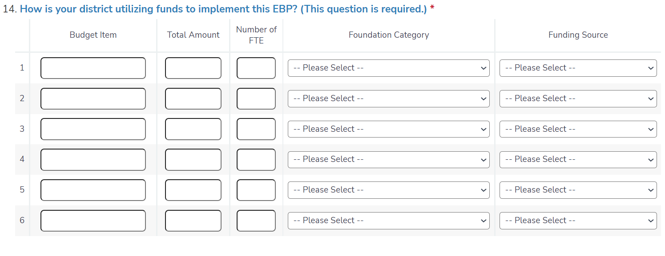
Entering FY22 Budget Detail
Notes:
Here’s a shot of the budget entry screen. You’ll enter information here by item and foundation category, as the SOA legislation requires. You can also identify the source of funding for each gap-closing measure, as we anticipate that not all initiatives will be funded by SOA Chapter 70 increases. NOTE THAT, LIKE LAST YEAR, YOU WILL COMPLETE A BUDGET FOR EACH EVIDENCE-BASED PROGRAM YOU’VE SELECTED, so don’t try to enter information about all of your programs into the first budget screen that appears.

Slide 20
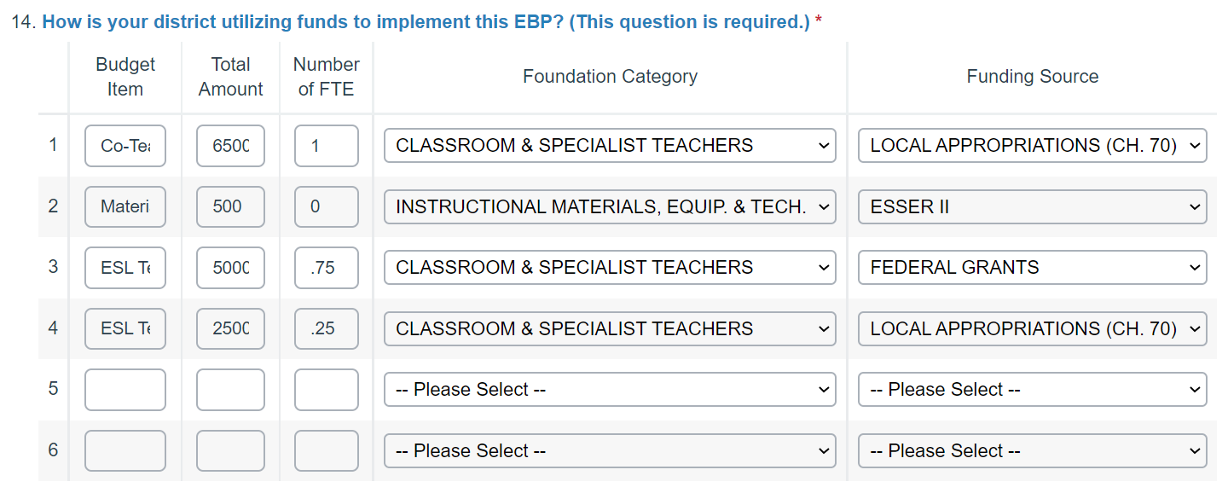
Entering FY22 Budget Detail
Notes:
Here’s how the budget screen may look with some data entries. We want to emphasize that, as the instructions will say, in the number entry columns don’t type any dollar signs or commas.

Slide 21
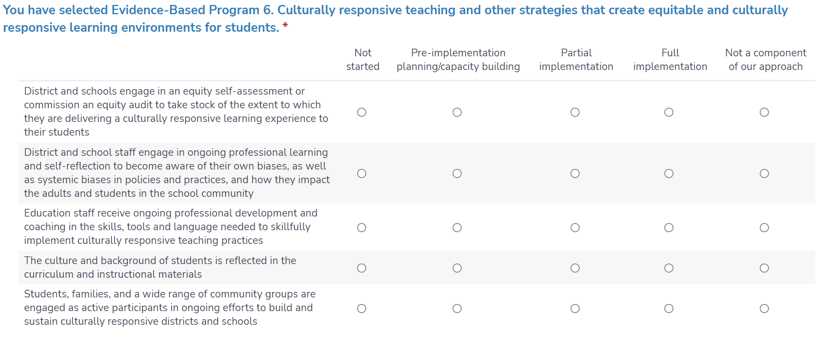
Gathering more detailed information about implementation
Notes:
The SOA legislation calls for districts to describe progress in implementation and closing gaps for student groups in their annual updates to DESE. We know that many of you are already making headway in implementing the evidence-based practices included in their original plans; at the same time, we know that thanks to the pandemic, implementation may be delayed.
In order to capture descriptive information on what districts are implementing and, at the same time, cut down on the amount of narrative information we ask districts to provide, we worked with our DESE program offices to develop between 3-10 implementation indicators for each evidence-based program area.
So, if your district selected Culturally responsive teaching and other strategies that create equitable and culturally responsive learning environments for students, once you have entered your budget information, this item will appear. We don’t assume that every district will be implementing everything on this list. For each item that is part of your district’s approach, indicate what stage of implementation you are at. If it’s part of your plan, but you haven’t yet begun, you would indicate “Not Started”. If you are in the pre-planning and capacity building stage , but haven’t yet rolled it out , you would click on the second column, pre-implementation planning/capacity building. Partial implementation would be used to for both the early and mid-stages of implementation and scaling up; you may find that you stay at this stage for a while for some items. Full implementation would indicate that your school has a mature implementation of a strategy. If an item isn’t a component of your district’s approach, you would select the far-right column.
Following this closed-ended item, you will be asked to share with us what your district’s next key step is in implementation – just a sentence or two to give us a sense of where you are headed next.
If there are other great strategies you are implementing that you want us to know about that are not included in the implementation item, we have also included an optional open-ended item where you can tell us about them. And although this item is optional, if your district adds an evidence-based program area wasn’t part of your original SOA plan, we would ask you to provide us with a brief narrative that provides context about why your district is focusing on this and any details that would help us better understand the context of your implementation. We would expect a more detailed description from long form districts, similar to what you provided last year. The exemplars for long form and short form districts are still available on the SOA Web site’s District resources page.
The SOA Implementation Indicators for 2021-2022 resource on the SOA District resources page provides instructions for completing the implementation indicators and includes a set of screen shots of the indicators for each of the 21 recommended SOA evidence-based program areas.

Slide 22
SOA Plan Amendment Timeline
Early December: amendment window opened
December – January: planning supports available
April 1, 2022: plan amendments due
August 1, 2022: Charter school amendments due
Notes:
Here’s the timeline for completing and submitting plan amendments. The amendment window is open. Superintendents were sent the link to the amendment template along with district logins. As plans are being revised districts can tap into the supports DESE is making available for various aspects of the process.
Charter schools are on a different timeline, and will submit their plan amendments by August 1, 2022.

Slide 23
SOA Resources and Supports
  Frequently asked questions
  Guidance for Development and Submitting FY22 SOA Plan Amendments
  FY22 Evidence-based Program Area Descriptions
  FY22 SOA Implementation Indicators Resource
  Coming soon - Slides and recordings of recent SOA webinars
    SOA Plan Amendment Overview
    SOA Family, Community, and Stakeholder Engagement
    SOA Metrics
  Data Support for Districts
Notes:
These are the major support pieces that are or will soon be available to support your work. The substance and quality of your plan matters very much, and we’re happy to assist you to ensure that it meets the needs of your students and families.

Slide 24
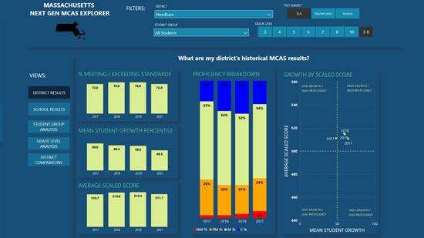
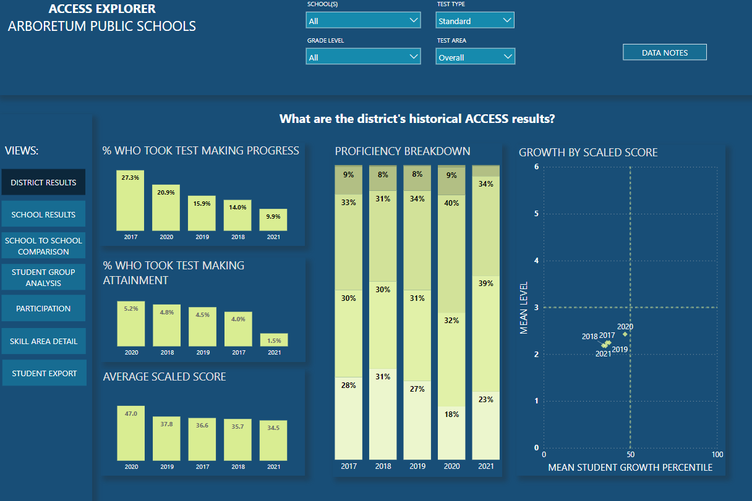
DESE Supports: Data Analytics
DESE has partnered with Open Architects to provide free support for developing your district goals.
Districts can learn more by visiting www.openarchitectsk12.com/soa-support
Notes:
DESE has partnered with Open Architects to provide free support for developing your district goals. These visualizations give MCAS and ACCESS insights at the district, school and student level. To learn more, you can visit the web address listed here, or find a link on the DESE Student Opportunity Act website.

Slide 25
How To Get Started
Next Steps
  Plan for and organize stakeholder engagement
  Revisit original SOA plan
  Resources can be found in the SOA District Resources page of the SOA website
  Use the provided template to start drafting responses
  If you have a question about whether a program you are considering meets requirements, please email SOAplans@mass.gov
Notes:
Here are what we see as districts' key next steps.
Plan for and organize stakeholder engagement. We know that ESSER III grant planning also involved stakeholder engagement, so you may be able to leverage those relationships to get their additional input as you develop your SOA plan amendment plan
We would encourage you to revisit your original SOA plan and ask yourselves –
are these still the most important evidence-based program areas to focus on to close opportunity and outcomes gaps for student groups?
and as you work on your budgets consider funds you use to support them with an eye towards sustainability of key programs over time. Between SOA funding and ESSER funding, many districts here today have a significant opportunity to both address immediate student needs and create thoughtful, multi-year plans for effective use of one-time funds represented by ESSER and recurring revenues from chapter 70.
Please check the SOA District Resources web page frequently for updated information on new resources and supports, many of which we have referenced throughout today’s webinar and appear on slide 24.
For instance, although we already sent out a link to the amendment template along with your usernames and passwords, we don’t expect most of your reflection and planning to be done seated in front of the template. The guidance document posted on the SOA web site lays out what the complete template entails – we recommend that you use this for reference as you begin drafting your responses. If you need a copy of your original SOA Plan, you can also find those on the SOA website.
Finally - If you have questions at any stage in the process – technical, programmatic, whatever -- please email us at SOAplans@mass.gov. When you send an email to that address, you are essentially reaching David and me – and we will get back to you with a response as soon as we can – typically within a day or two.

Slide 26
Thank you
Thank You
District Resources: Guidance Materials and SOA Plan Template - Student Opportunity Act (mass.edu)
Notes:
Thank you so much for joining us here today.

