Slide 1
Massachusetts World Languages Framework Curriculum Alignment Lab #2
November 8, 2022
Andy McDonie
World Languages Lead, Office of Language Acquisition

Slide 2
Overview
Today we will…
Review and discuss the content of Online Modules 4-6
Explore sections of the Curriculum Alignment Guide for Unit Planning with a focus on Interpersonal and Presentational Communication
View and discuss sample unit plans with a focus on Interpersonal and Presentational Communication
Discuss ways in which you can apply what you’ve learned to your own classroom

Slide 3
Review and Discussion: Modules 4, 5, 6
Review and Discussion: Modules 4, 5, 6

Slide 4
Module 4 Review
Overview
Reviews the ACTFL Proficiency Guidelines
Introduces the Communication Standards in the Framework
Explains how the Communication Standards progress across proficiency levels

Slide 5
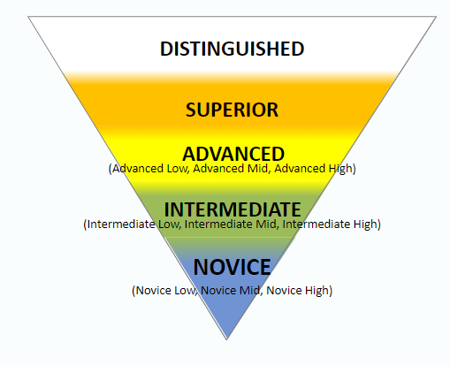
Module 4 Review
What are the ACTFL Proficiency Guidelines?
Description of what individuals can do with language in real-world situations in a spontaneous and non-rehearsed context
    Guidelines for speaking, writing, listening, and reading; can be applied to signing and viewing
Focus on proficiency over grammar in contrast to traditional language teaching
  Each level is a range that subsumes all lower levels
    High sublevel represents learners who are starting to function at the next level but can’t sustain it

Slide 6
Module 4 Review
What are the Communication Standards?
Content Standards related to how students use language
Modes of communication = Communication Practices in Domain 1
    Interpretive
    Interpersonal
    Presentational
    Intercultural
Include the skills of reading, writing, listening, viewing, speaking, and signing, organized by the tasks students accomplish with language

Slide 7
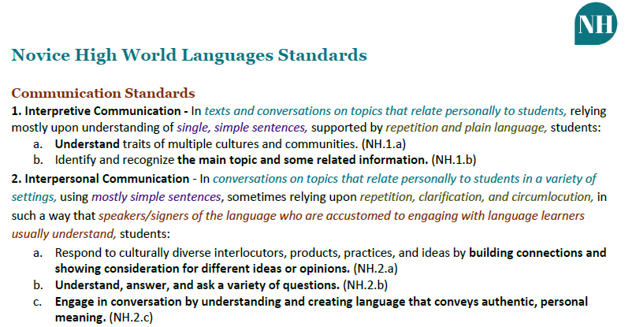
Components of the Content Standards (Review from Module 1)
Context
Support
Functions
Comprehensibility
Text Type
Notes:
[CLICK to highlight each component]
Function (lettered lists): describes what students can do with the language.
Context (teal italicized text): Describes the situations in which students successfully perform the function.
Text Type (purple text): Describes the quality and quantity of language that students produce.
Comprehensibility (italicized red-brown text): Describes if and how easily the audience will understand the student.
Support (olive green text): Describes what supports students will likely need in order to accomplish the function.

Slide 8
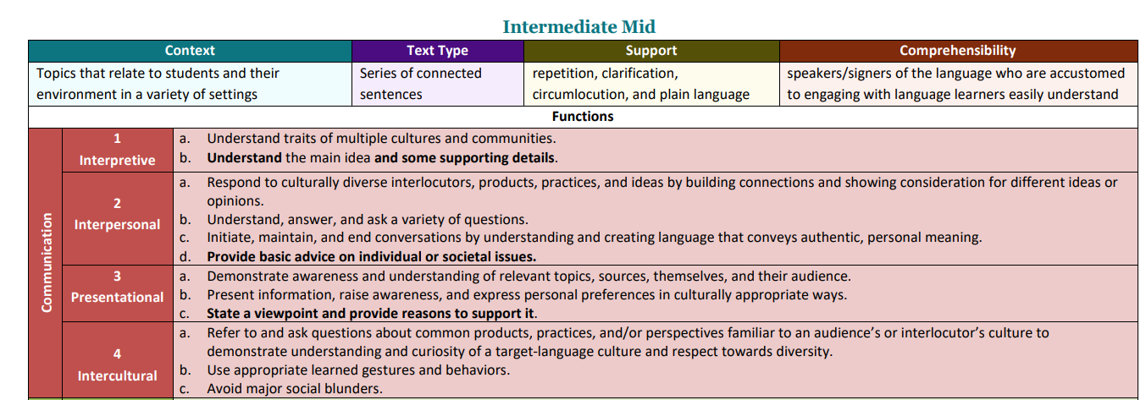
Resource: Content Standards at a Glance

Slide 9









Module 4 Review
How do the Communication Standards progress across proficiency levels?
As the proficiency level increases…
Functions increase and are more complex
Contexts are broader
Text Types are more complex
Supports decrease
Comprehensibility increases

Slide 10
Questions from Module 4?

Slide 11
Module 5 Review
Overview
Explains the Interpersonal Communication mode and why it’s important for world language education
Explores the Massachusetts World Languages Standards for Interpersonal Communication
Discusses how to address the Interpersonal Communication Standards in the classroom

Slide 12











Module 5 Review
What do students do in the mode of Interpersonal Communication?
Exercise reading, viewing, listening, writing, signing, and speaking skills to seek, convey, and/or exchange information and negotiate the meaning of messages in authentic, synchronous conversations
Exercise cultural understanding and social skills to effectively exchange and explore information with their interlocutor(s)
Notes:
*Emphasize that “exercising” is not just “practicing” these skills and includes using these skills in authentic conversations and situations

Slide 13

Module 5 Review
What are the Interpersonal Communication Standards?
Descriptions of Interpersonal Communication skills that students demonstrate at different levels of proficiency
Each Interpersonal Communication Standard contains between three and seven Functions numbered 2.a-2.g
2. Interpersonal Communication - In conversations on topics that relate to students and their immediate environment in a variety of settings, creating unconnected simple sentences, sometimes relying upon repetition, clarification, and circumlocution, in such a way that speakers/signers of the language who are accustomed to engaging with language learners understand, students:
Respond to culturally diverse interlocutors, products, practices, and ideas by building connections and showing consideration for different ideas or opinions. (IL.2.a)
Understand, answer, and ask a variety of questions. (IL.2.b)
Initiate, maintain, and end conversations by understanding and creating language that conveys authentic, personal meaning. (IL.2.c)

Slide 14
Module 5 Review
How do the Functions progress across proficiency levels?
Functions | Proficiency Levels
 | NL | NM | NH | IL | IM | IH | AL | AM | AH | S
a. | ✓ | ✓ | ✓+ | ✓ | ✓ | ✓ | ✓ | ✓ | ✓+ | ✓
b. | ✓ | ✓+ | ✓+ | ✓ | ✓ | ✓+ | ✓+ | ✓ | ✓+ | ✓
c. | ✓ | ✓+ | ✓+ | ✓+ | ✓ | ✓+ | ✓+ | ✓ | ✓ | ✓
d. |  |  |  |  | ✓ | ✓+ | ✓ | ✓ | ✓+ | ✓
e. |  |  |  |  |  | ✓ | ✓+ | ✓ | ✓+ | ✓
f. |  |  |  |  |  |  | ✓ | ✓ | ✓+ | ✓
g. |  |  |  |  |  |  |  |  | ✓ | ✓+
Notes:
As shown in the chart, some Functions are repeated from level to level (as indicated by a check mark) and some Functions progress from level to level (as indicated by a check mark in a new row or a check mark with a plus sign). These Functions, which are brand new Functions that emerge at higher proficiency levels or new, more rigorous features of a previously acquired Function, appear in bolded text within the Framework.

Slide 15
Module 5 Review
How can I address the Interpersonal Communication Standards in my classroom?
Select a goal or Can-Do statement aligned with the Standards for targeted proficiency level(s)
Design an aligned assessment task that encourages spontaneous language
  Build upon Interpretive Communication task(s)
  Inform subsequent Presentational Communication task(s)
Provide continuous meaningful opportunities to communicate
Design learning experiences with all students in mind, including students with disabilities and students from diverse linguistic, racial, and cultural backgrounds
Connect to Deeper Learning through opportunities for students to demonstrate Mastery, Identity, and Creativity

Slide 16
Questions from Module 5?

Slide 17
Module 6 Review
Overview
Explains the Presentational Communication mode and why it’s important for world language education
Explores the Massachusetts World Languages Standards for Presentational Communication
Discusses how to address the Presentational Communication Standards in the classroom

Slide 18





Module 6 Review
What do students do in the mode of Presentational Communication?
Employ writing, signing, and/or speaking skills to plan and prepare communications for a specific audience
Employ their knowledge of their audiences and their own culture(s) and perspective(s) to communicate authentic messages that will be well-received by their listeners, readers, or viewers in the target language

Slide 19
Module 6 Review
What are the Presentational Communication Standards?
Descriptions of Presentational Communication skills that students demonstrate at different levels of proficiency
Each Presentational Communication Standard contains between two and five Functions numbered 3.a-3.e
3. Presentational Communication - In presentations on topics that relate to students and their immediate environment in a variety of settings, creating unconnected simple sentences, sometimes relying upon clarification and circumlocution, in such a way that speakers/signers of the language who are accustomed to engaging with language learners understand, students:
Demonstrate awareness and understanding of relevant topics, sources, themselves, and their audience. (IL.3.a)
Present information, raise awareness, and express personal preferences in culturally appropriate ways. (IL.3.b)
c. Explain their own authentic thoughts in culturally appropriate ways. (IL.3.c)

Slide 20
Module 6 Review
How do the Functions progress across proficiency levels?
Functions | Proficiency Levels
 | NL | NM | NH | IL | IM | IH | AL | AM | AH | S
a. | ✓ | ✓ | ✓+ | ✓ | ✓ | ✓+ | ✓+ | ✓ | ✓+ | ✓
b. | ✓ | ✓ | ✓ | ✓+ | ✓ | ✓ | ✓+ | ✓+ | ✓+ | ✓+
c. |  |  | ✓ | ✓+ | ✓+ | ✓+ | ✓+ | ✓+ | ✓+ | ✓+
d. |  |  |  |  |  | ✓ | ✓+ | ✓+ | ✓ | ✓+
e. |  |  |  |  |  |  |  |  | ✓ | ✓+

Slide 21
Module 6 Review
How can I address the Presentational Communication Standards in my classroom?
Select a goal or Can-Do statement aligned with the Standards for targeted proficiency level(s)
Design an aligned assessment task that encourages rehearsed, polished language use
  Reflects an authentic situation in which students would present information
  May use various multimedia tools, materials, and resources
  Practice different formats and presenting to difference audiences
Expose students to various products during interpretive activities
Design learning experiences with all students in mind, including students with disabilities and students from diverse linguistic, racial, and cultural backgrounds
Connect to Deeper Learning through opportunities for students to demonstrate Mastery, Identity, and Creativity

Slide 22
Questions for Reflection
  Q&A in the Main Room
  What are your students’ proficiency levels according to the ACTFL scale?
  How might you address Interpersonal Communication in your classroom?
  How might you address Presentational Communication in your classroom?

Slide 23
Discussion Questions
  Discussion in Breakout Rooms
  How do you currently address Interpersonal Communication in your classroom?
  How do you currently address Presentational Communication in your classroom?
  How might you add to your current approaches based on Modules 4, 5, and 6?

Slide 24
Exploring the Curriculum Alignment Guide
Exploring the Curriculum Alignment Guide

Slide 25
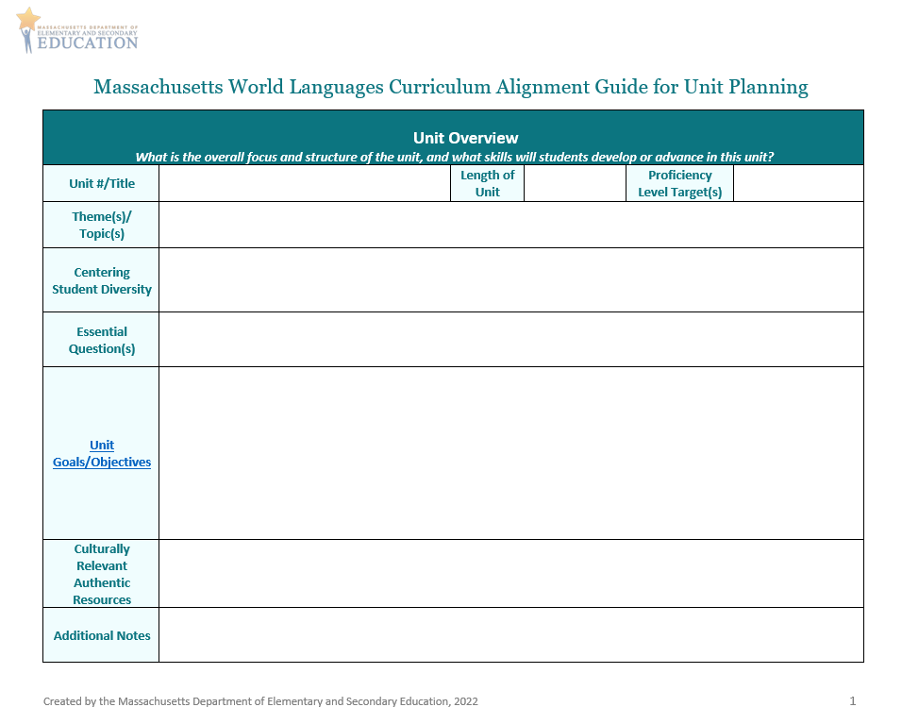
Curriculum Alignment Guide for Unit Planning (1/5)
Unit Overview
  In the Unit Goals/Objectives section, think about what you want students to be able to do in Interpersonal and Presentational Communication by the end of the unit
    Refer to the Centering Student Diversity box when creating goals/objectives for these modes!
Notes:
Classical language teachers may decide to focus more on goals/objectives for interpretive and intercultural communication while still providing opportunities for their students to develop and advance their interpersonal and presentational communication skills. The interpersonal and presentational modes may be expressed or demonstrated at lower levels of proficiency.

Slide 26
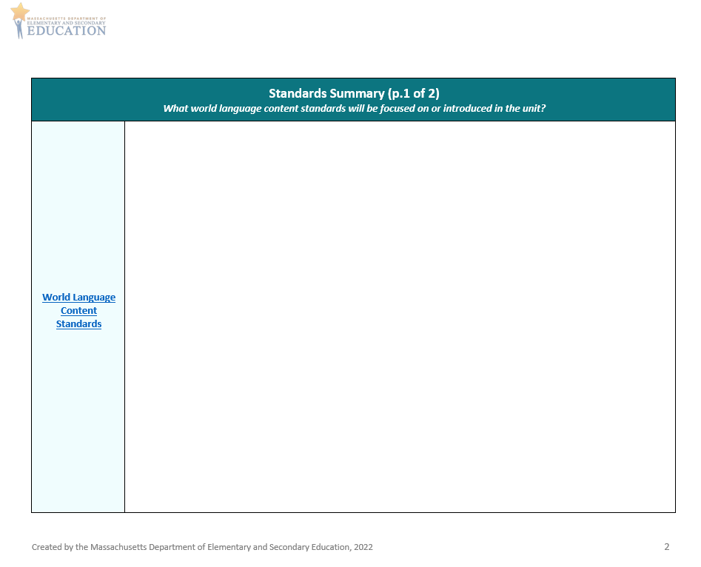
Curriculum Alignment Guide for Unit Planning (2/5)
Standards Summary
  What Interpersonal and Presentational Standards will you focus on?
  Are there other standards you would like to integrate and address via Interpersonal and Presentational Communication in this unit?

Slide 27
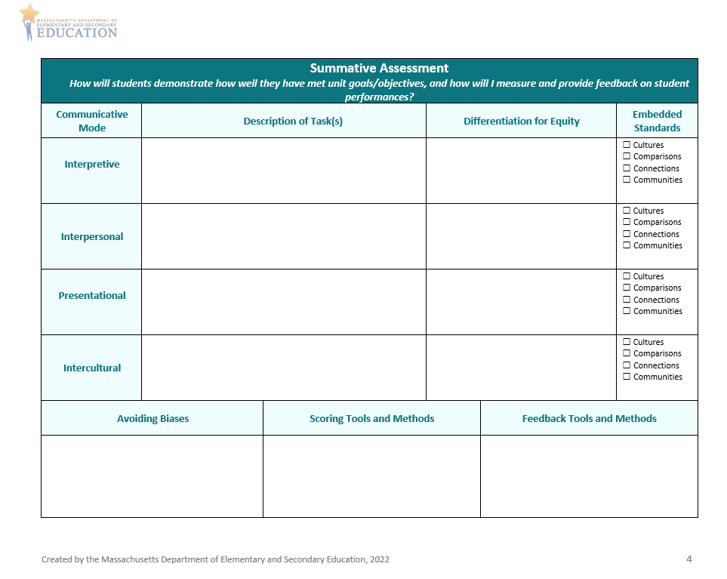
Curriculum Alignment Guide for Unit Planning (3/5)
Summative Assessment
  Consider how students will show what they can do in the Interpersonal and Presentational modes
    How can you differentiate your tasks?
    How can you represent your students’ backgrounds, identities, and experiences?
    How can you measure student performances?
    How can you provide feedback on student performances?
  Consider how to simultaneously assess embedded standards of Cultures, Comparisons, Connections, and Communities
  Remember to provide opportunities for students to demonstrate Mastery, Identity, and Creativity
*
*
*
*
*
*
*
*
*

Slide 28
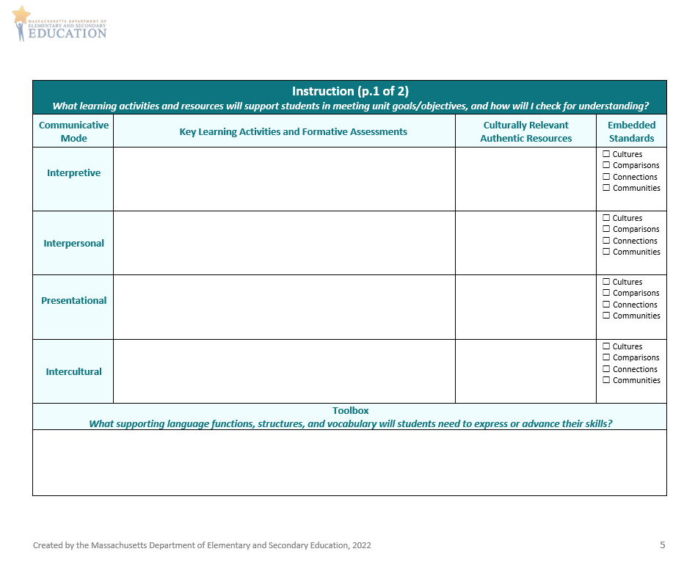
Curriculum Alignment Guide for Unit Planning (4/5)
Instruction p. 1
  Consider what learning activities will support students in meeting unit goals/objectives for Interpersonal and Presentational Modes
    How will you check for understanding and determine if additional supports are needed?
    What culturally relevant authentic resources will you use?
    What supporting language functions, grammatical structures, and vocabulary do students need in their toolbox?
  Consider how to simultaneously teach embedded standards of Cultures, Comparisons, Connections, and Communities
  Remember to provide opportunities for students to demonstrate Mastery, Identity, and Creativity
*
*
*
*
*
*
*

Slide 29
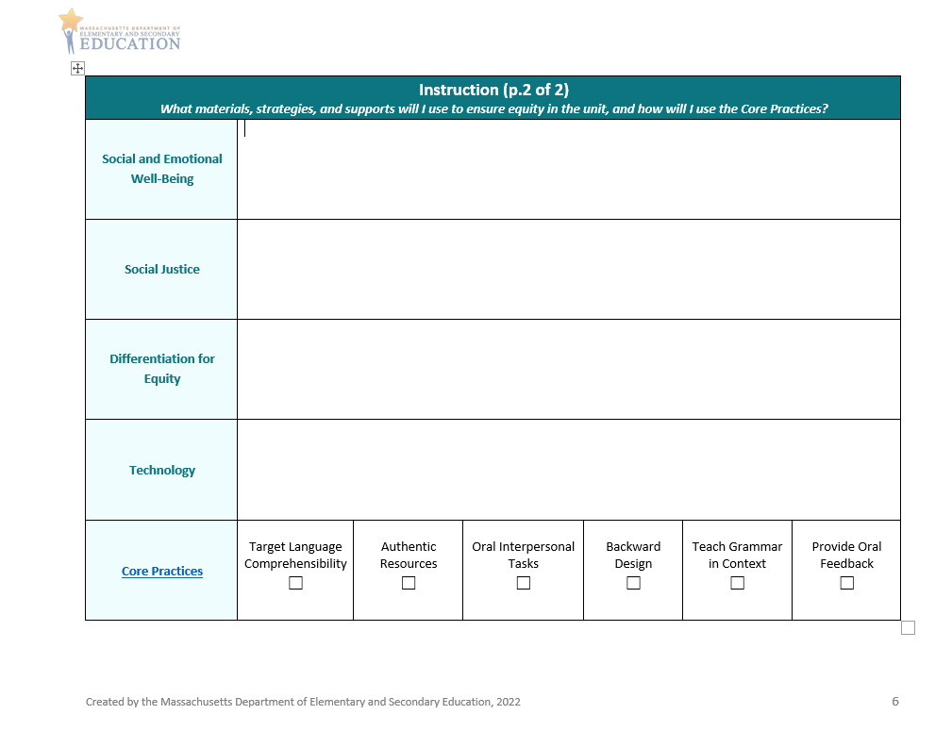
Curriculum Alignment Guide for Unit Planning (5/5)
Instruction p. 2
  Consider what materials and strategies will support students in meeting unit goals/objectives for Interpersonal and Presentational Modes
    How will you address Social and Emotional Well-Being and Social Justice?
    How will you ensure equity and representation?
    How will you integrate technology, and what supports will be needed?
    How will you use Core Practices to enhance student learning?

Slide 30
Demonstration and Discussion: Sample Unit Plans
Demonstration and Discussion: Sample Unit Plans

Slide 31
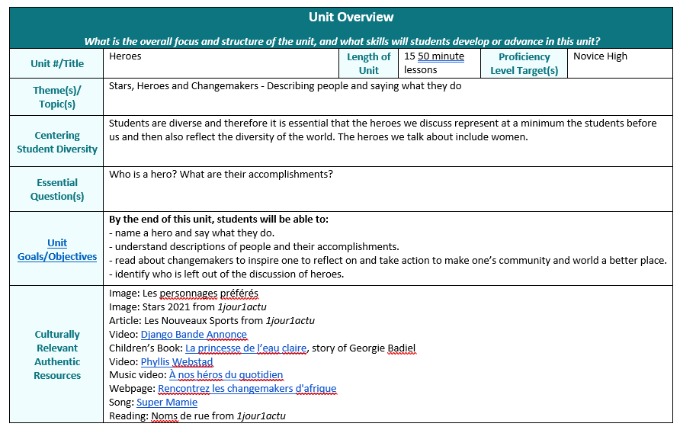
Unit Overview

Slide 32
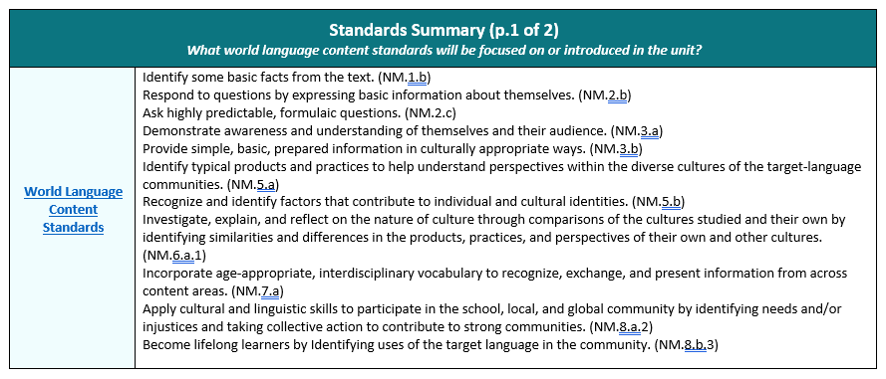
Standards Summary p. 1

Slide 33
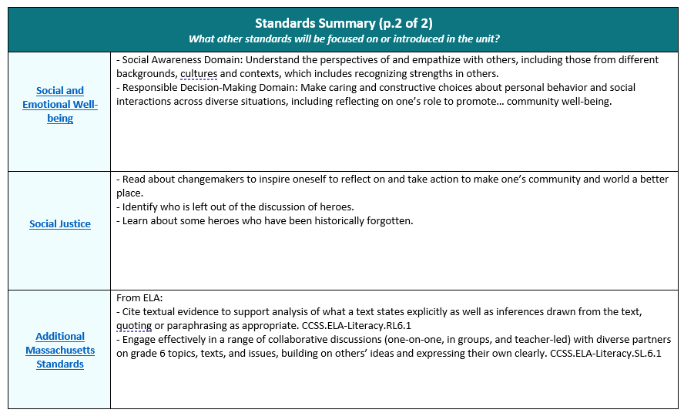
Standards summary p. 2

Slide 34
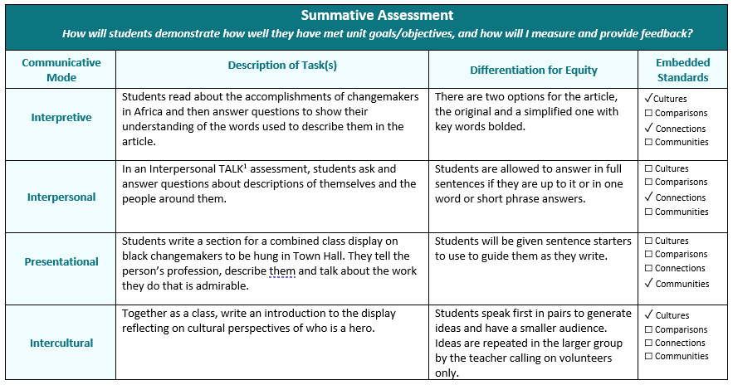
Summative Assessment

Slide 35
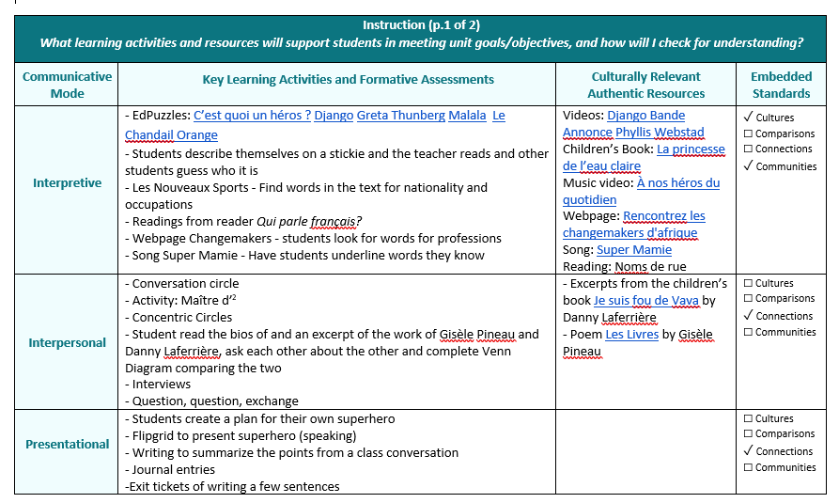
Instruction p. 1

Slide 36
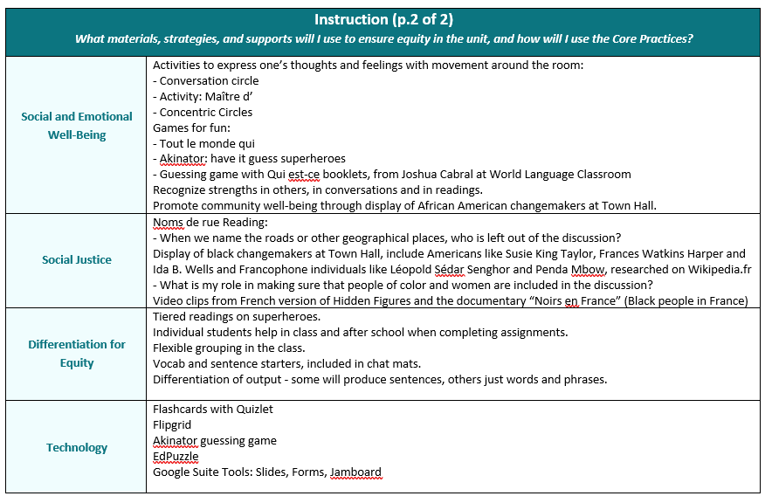
Instruction p. 2

Slide 37
Discussion Questions
Discussion in the Breakout Rooms
What did you notice about Interpersonal Communication in these samples?
What did you notice about Presentational Communication in these samples?
How do these plans ask students to demonstrate Mastery, Identity, and Creativity through these modes of Communication?

Slide 38
Application and Discussion
Application and Discussion

Slide 39
Discussion
Discussion in Breakout Rooms
What did you learn in Modules 4, 5, and 6 that will help you in your teaching?
What are some strengths of the sample unit plans? How could they be improved?
What ideas and questions do you have to share about aligning your own units using the Curriculum Alignment Guide?

Slide 40
Wrap-up and Next Steps
Wrap Up and Next Steps

Slide 41
Preview and Next Steps
In our next Curriculum Alignment Lab, we will…
Review and discuss Modules 7 and 8
Explore sections of the Curriculum Alignment Guide for Unit Planning with a focus on Interpretive and Intercultural Communication
View and discuss sample unit plans with a focus on Interpretive and Intercultural Communication
Discuss ways in which you can apply what is learned to your own classroom
Register now for a CAL 3 lab
Let us know how we did. Take our evaluation survey.

Slide 42
Check for Learning
Check for Learning in Main Room
What are the Communication Standards?
How are the Communication Standards organized in the Framework?
What is Interpersonal Communication?
How is Interpersonal Communication addressed in the Curriculum Alignment Guide?
What is Presentational Communication?
How is Presentational Communication addressed in the Curriculum Alignment Guide?

Slide 43




Thank you
THANK YOU
[Enter names of presenters]
781-338-3000
worldlanguages@mass.gov
www.doe.mass.edu
75 Pleasant Street, Malden, MA 02148

