Slide 1
Massachusetts World Languages Framework Curriculum Alignment Lab #5
[Insert DATE]
[Insert Names and Titles of Presenters]

Slide 2
Overview
Today we will…
Briefly review the content of Online Modules 12–14
Explore and discuss sections of the Curriculum Alignment Guide for Unit Planning with a focus on Connections and Communities
View and discuss sample unit plans with a focus on Connections and Communities
Discuss ways in which you can apply what you’ve learned to your own classroom

Slide 3
Review and Discussion: Modules 12, 13, 14
Review and Discussion: Modules 12, 13, 14

Slide 4
Module 12 Review
Overview
Introduces the Lifelong Learning Standards in the Framework
Explains how the Lifelong Learning Standards progress across proficiency levels

Slide 5
Module 12 Review
Standards for World Languages Practice
Communication
Linguistic Cultures
Lifelong Learning
What are the Lifelong Learning Standards?
Express why students communicate in the target language
Four Practices comprise Domain 2
  Connections
  Communities
  Social and Emotional Well-Being
  Social Justice
Accomplished through the Communicative Modes in Domain 1
Provide content, context, and purpose for Communication
Implicit and woven throughout all standards

Slide 6













Module 12 Review
Why are the Lifelong Learning Standards important?
Empower students to act with cultural competence and critical consciousness
Foster risk-taking and mistake-making toward growth in linguistic and cultural proficiency
Support meaningful, authentic, and affirming interactions in the target language
Promote social and emotional growth
Deliver meaningful, relevant, and cross-disciplinary content to motivate students to acquire the language and build proficiency
Provide an avenue for students to become critical thinkers, good problem solvers, and informed, engaged global citizens
Connect students to their peers in the classroom, their community, and speakers/signers of the target language throughout the world

Slide 7






Module 12 Review
How do the Lifelong Learning Standards progress across proficiency levels?
Text Types remain: The target language exclusively (or almost exclusively)
For Communities – or to the maximum extent that the community-based standards require
As the proficiency level increases…
Supports remain: Appropriate linguistic scaffolding
Functions increase and are more complex
Contexts are broader
Comprehensibility is not included

Slide 8
Module 12 Review
Questions?

Slide 9
Module 13 Review
Overview
Explains Practice 7: Connections and why it’s important for world language education
Explores the Massachusetts World Languages Standards for Connections
Discusses how to address the Connections Standards in the classroom

Slide 10
Module 13 Review
What do students do in Practice 7: Connections?
Build, reinforce, and expand interdisciplinary knowledge
Develop skills that are necessary for success in a globalized, diverse 21st Century society
Explore and analyze diverse perspectives across and within cultures
Employ creativity, innovation, flexibility, and adaptability to engage in critical-thinking, inquiry, and problem-solving in all disciplines
Perspectives
Ideas, values, attitudes

Slide 11

Module 13 Review
What are the Connections Standards?
Descriptions of Connections skills that students demonstrate at different levels of proficiency
Each Connections Standard contains two Functions numbered 7.a and 7.b
Lifelong Learning Standards
7. Connections - In a variety of settings, using the target language exclusively or almost exclusively, with appropriate linguistic scaffolding, students fully and consistently:
Incorporate age-appropriate, interdisciplinary vocabulary to understand, exchange, and present information from across content areas. (IM.7.a)
Understand, exchange, and present diverse perspectives and distinctive viewpoints from authentic age-appropriate materials. (IM.7.b)

Slide 12
Module 13 Review
How do the Functions progress across proficiency levels?
Functions | Proficiency Levels
 | NL | NM | NH | IL | IM | IH | AL | AM | AH | S
a. | ✓ | ✓ | ✓ | ✓ | ✓ | ✓ | ✓ | ✓ | ✓+ | ✓
b. | ✓ | ✓ | ✓+ | ✓ | ✓ | ✓+ | ✓ | ✓ | ✓+ | ✓
No progression of text type or supports
Notes:
As shown in the chart, some Functions are repeated from level to level (as indicated by a check mark) and some Functions progress from level to level (as indicated by a check mark with a plus sign). These Functions, which are new, more rigorous features of a previously acquired Function, appear in bolded text within the Framework.

Slide 13












Module 13 Review
How can I address the Connections Standards in my classroom?
Use essential questions and themes to guide instruction
Use technology to facilitate connections beyond the classroom
Expose students to a variety of authentic texts and resources that present a diverse variety of perspectives in the target-language culture
Promote student autonomy and ownership of their learning
Incorporate interdisciplinary topics
Make connections to content being learned in other classes
Notes:
Remind participants that texts are defined as any authentic conveyor of information from target-language cultures

Slide 14
Module 13 Review
Questions?

Slide 15
Module 14 Review
Overview
Explains Practice 8: Communities and why it’s important for world language education
Explores the Massachusetts World Languages Standards for Communities
Discusses how to address the Communities Standards in the classroom

Slide 16
Module 14 Review
What do students do in Practice 8: Communities?
Maintain engagement in the target-language community
Consider diverse perspectives, build empathy, and act collectively to contribute to strong communities
Recognize strengths, set goals for growth, and reflect upon progress in using languages for enjoyment, enrichment, career advancement, and building diverse relationships

Slide 17

Module 14 Review
What are the Communities Standards?
Descriptions of Communities skills that students demonstrate at different levels of proficiency
Each Communities Standard contains six Functions
  Functions related to applying cultural and linguistic skills are numbered 8.a.1 and 8.a.2
  Functions related to becoming lifelong learners are numbered 8.b.1-8.b.4
8. Communities - In a variety of settings, using the target language to the greatest appropriate extent for the community-based situation, with appropriate linguistic scaffolding, students fully and consistently:
Apply cultural and linguistic skills to participate in the school, local, and global community by:
  Engaging with resources and assets in the community such as individuals and organizations or technological tools to further investigate and enjoy target-language cultures. (IM.8.a.1)
  Identifying needs and/or injustices and designing and taking collective action to contribute to strong communities. (IM.8.a.2)
Become lifelong learners by:
  Using languages for enjoyment and enrichment and accessing and evaluating further opportunities for doing so. (IM.8.b.1)
  Interacting on a regular basis with speakers/signers of the target language to build diverse relationships. (IM.8.b.2)
  Explaining language education requirements for careers of interest. (IM.8.b.3)
  Setting goals for growth in these areas and reflecting upon progress. (IM.8.b.4)

Slide 18
Module 14 Review
How do the Functions progress across proficiency levels?
Functions | Proficiency Levels
 | NL | NM | NH | IL | IM | IH | AL | AM | AH | S
a.1 | ✓ | ✓ | ✓+ | ✓ | ✓ | ✓+ | ✓ | ✓ | ✓ | ✓
a.2 | ✓ | ✓ | ✓+ | ✓ | ✓ | ✓+ | ✓ | ✓ | ✓+ | ✓
b.1 | ✓ | ✓ | ✓+ | ✓ | ✓ | ✓+ | ✓ | ✓ | ✓+ | ✓
b.2 | ✓ | ✓ | ✓+ | ✓ | ✓ | ✓ | ✓ | ✓ | ✓ | ✓
b.3 | ✓ | ✓ | ✓+ | ✓ | ✓ | ✓+ | ✓ | ✓ | ✓+ | ✓
b.4 | ✓ | ✓ | ✓+ | ✓ | ✓ | ✓+ | ✓ | ✓ | ✓ | ✓
No progression of text type or supports
Notes:
As shown in the chart, some Functions are repeated from level to level (as indicated by a check mark) and some Functions progress from level to level (as indicated by a check mark with a plus sign). These Functions, which are new, more rigorous features of a previously acquired Function, appear in bolded text within the Framework.

Slide 19







Module 14 Review
How can I address the Communities Standards in my classroom?
Design hands-on learning activities within and beyond the classroom
Provide opportunities to connect with local community organizations
Leverage students’ existing connections to multilingual communities
Use technology to facilitate interactions with global communities
Encourage students to pursue their interests through the language
Provide opportunities for project-based or experiential learning
Provide time for reflection on goals and growth

Slide 20
Module 14 Review
Questions?

Slide 21
Questions for Reflection
  Q&A in the Main Room
  Why do your students want to communicate in the target language?
  How might you address Connections in your classroom?
  How might you address Communities in your classroom?

Slide 22
Discussion Questions
  Discussion in Breakout Rooms
  How do you currently address Connections in your classroom?
  How do you currently address Communities in your classroom?
  How might you add to your current approaches based on Modules 12, 13, and 14?

Slide 23
Exploring the Curriculum Alignment Guide
Exploring the Curriculum Alignment Guide

Slide 24
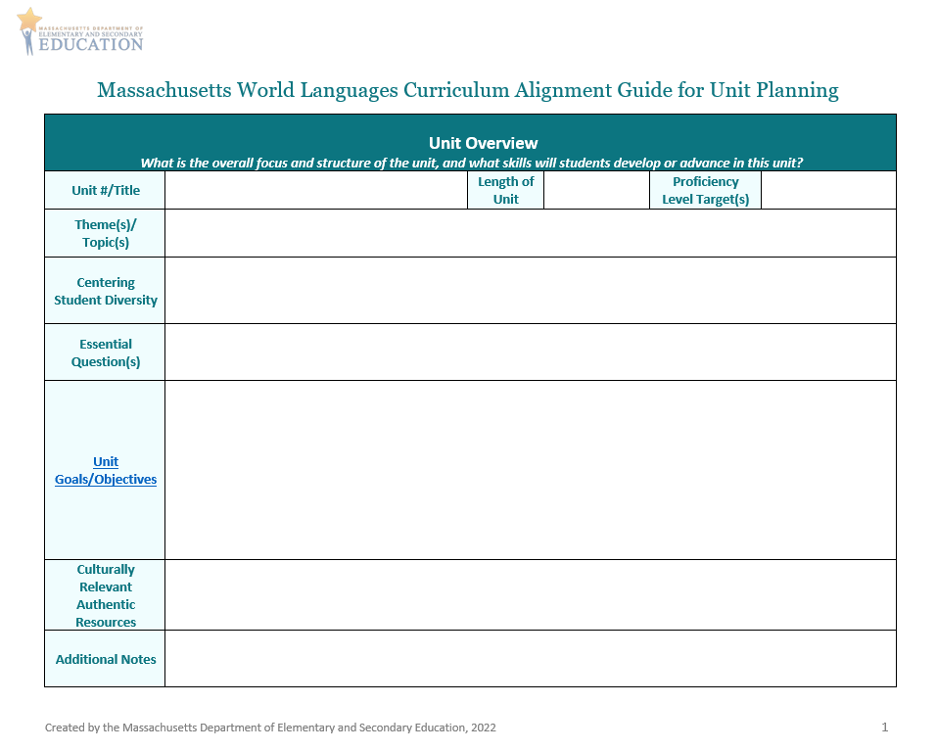
Curriculum Alignment Guide for Unit Planning (1/5)
Unit Overview
  In the Unit Goals/Objectives section, think about what you want students to be able to do in Connections and Communities by the end of the unit
    Refer to the Centering Student Diversity box when creating goals/objectives for these modes!
    Think about the culturally-relevant authentic resources that you could use in your unit

Slide 25
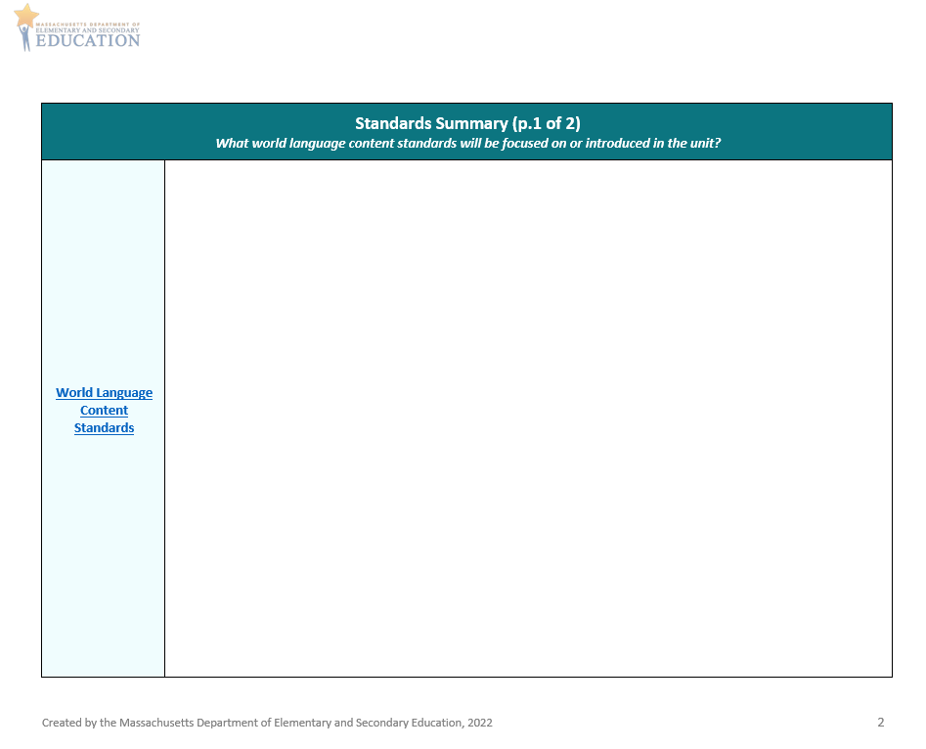
Curriculum Alignment Guide for Unit Planning (2/5)
Standards Summary
  What Connections and Communities Standards will you focus on?
  Are there other standards you would like to integrate and address in this unit that relate to Connections and Communities?

Slide 26
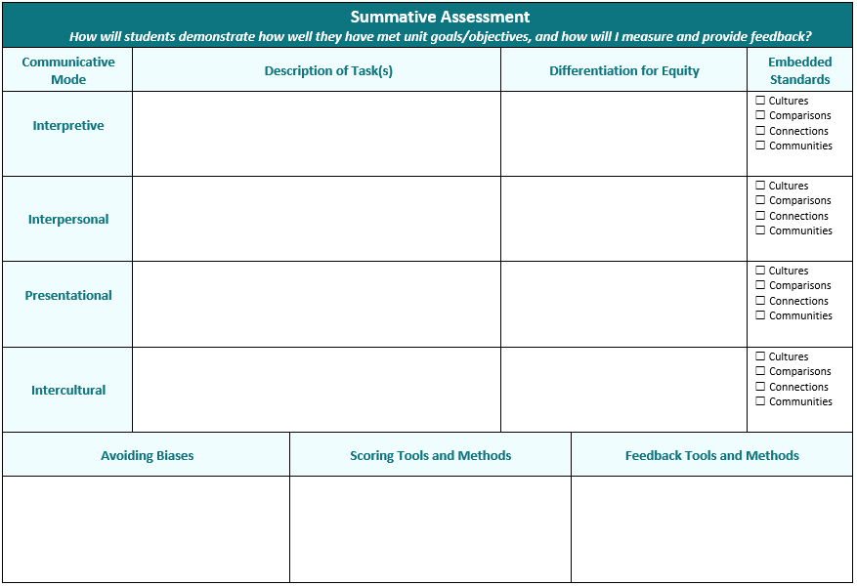
Curriculum Alignment Guide for Unit Planning (3/5)
Summative Assessment
  Consider how students will show what they can do in the areas of Connections and Communities via the Communicative Modes
    How can you differentiate your tasks?
    How can you represent your students’ backgrounds, identities, and experiences?
    How can you measure student performances?
    How can you provide feedback on student performances?
  Remember to provide opportunities for students to demonstrate Mastery, Identity, and Creativity
*
*
*
*
*
*
*
*
*
*
*
Notes:
To address these Standards in your classroom, it is important to embed them into your unit goals/objectives, your summative assessment tasks, and your learning activities and experiences. Rather than being addressed in isolation or through mini-lessons on topics related to culture, the Connections and Communities Standards should be simultaneously addressed through tasks and activities targeting each of the communicative modes.

Slide 27
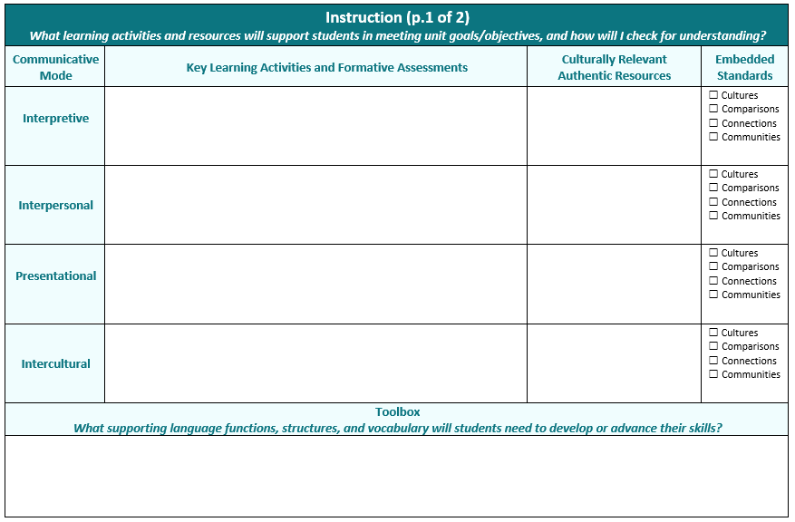
Curriculum Alignment Guide for Unit Planning (4/5)
Instruction p. 1
  Consider what learning activities will support students in meeting unit goals/objectives for Connections and Communities
    How will you check for understanding and determine if additional supports are needed?
    What culturally relevant authentic resources will you use?
    What supporting language functions, grammatical structures, and vocabulary do students need in their toolbox?
  Consider how the Lifelong Learning areas can be embedded within different Communicative Modes
  Remember to provide opportunities for students to demonstrate Mastery, Identity, and Creativity
*
*
*
*
*
*
*
*
*

Slide 28
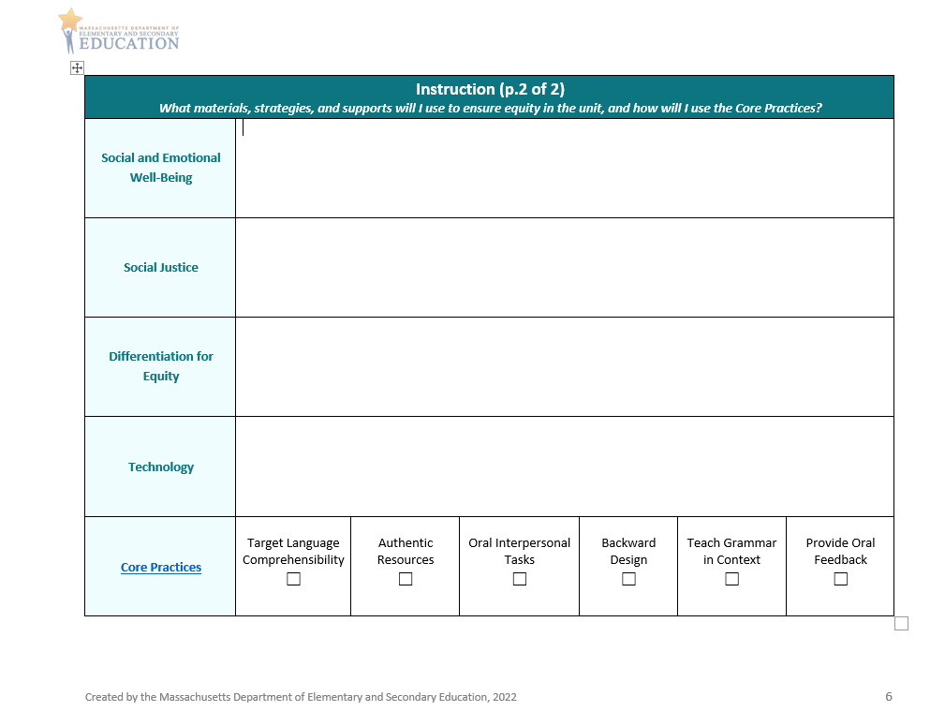
Curriculum Alignment Guide for Unit Planning (5/5)
Instruction p. 2
  Consider what materials and strategies will support students in meeting unit goals/objectives for Connections and Communities
    How will you address Social and Emotional Well-Being and Social Justice?
    How will you ensure equity and representation?
    How will you integrate technology, and what supports will be needed?
    How will you use Core Practices to enhance student learning?

Slide 29
Demonstration and Discussion: Sample Unit Plans
Demonstration and Discussion: Sample Unit Plans

Slide 30
Space to insert sample unit plans
Insert samples when available

Slide 31
Discussion Questions
Discussion in the Main Room
What did you notice about Connections in these samples?
What did you notice about Communities in these samples?
How do these plans ask students to demonstrate Mastery, Identity, and Creativity through these Practices?

Slide 32
Application and Discussion
Application and Discussion

Slide 33
Discussion Questions
Discussion in Breakout Rooms
What did you learn in Modules 12, 13 and 14 that will help you in your teaching?
What are some strengths of the sample unit plans? How could they be improved?
What ideas and questions do you have to share about aligning your own units using the Curriculum Alignment Guide?

Slide 34
Wrap Up and Next Steps
Wrap Up and Next Steps

Slide 35
Check for Learning
Check for Learning in Main Room
What are the Lifelong Learning Standards?
How are the Lifelong Learning Standards organized in the Framework?
What is Practice 7: Connections?
What is Practice 8: Communities?
How are Practices 7 and 8 addressed in the Curriculum Alignment Guide?

Slide 36




Thank you
THANK YOU
[Enter names of presenters]
781-338-3000
worldlanguages@mass.gov
www.doe.mass.edu
75 Pleasant Street, Malden, MA 02148

